Slide 1
Module 3
Java Persistence using JPA and Hibernate

Slide 2
Content to be discussed
Hibernate
ORM
Querying – HQL,HCQL
Caching
Performance and Concurrency
JPA
JPQL

Slide 3
Hibernate Framework
Hibernate is a Java framework that simplifies the development of Java application to interact with the database.
It is an open source, lightweight, ORM (Object Relational Mapping) tool.
Hibernate implements the specifications of JPA (Java Persistence API) for data persistence.
https://www.udemy.com/course/hibernate-and-jpa-fundamentals/

Slide 4
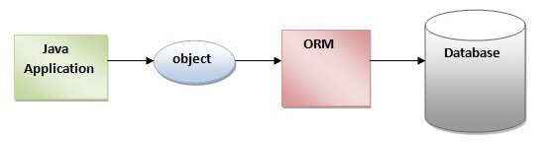
ORM Tool
An ORM tool simplifies the data creation, data manipulation and data access.
It is a programming technique that maps the object to the data stored in the database.
The ORM tool internally uses the JDBC API to interact with the database.
What is JPA?
Java Persistence API (JPA) is a Java specification that provides certain functionality and standard to ORM tools. The javax.persistence package contains the JPA classes and interfaces.

Slide 5
Advantages of Hibernate Framework
1) Open Source and Lightweight
Hibernate framework is open source under the LGPL license and lightweight.
2) Fast Performance
The performance of hibernate framework is fast because cache is internally used in hibernate framework. There are two types of cache in hibernate framework first level cache and second level cache. First level cache is enabled by default.
3) Database Independent Query
HQL (Hibernate Query Language) is the object-oriented version of SQL. It generates the database independent queries. So you don't need to write database specific queries. Before Hibernate, if database is changed for the project, we need to change the SQL query as well that leads to the maintenance problem.
4) Automatic Table Creation
Hibernate framework provides the facility to create the tables of the database automatically. So there is no need to create tables in the database manually.
5) Simplifies Complex Join
Fetching data from multiple tables is easy in hibernate framework.
6) Provides Query Statistics and Database Status
Hibernate supports Query cache and provide statistics about query and database status.

Slide 6
Hibernate Architecture
The Hibernate architecture includes many objects such as persistent object, session factory, transaction factory, connection factory, session, transaction etc.
The Hibernate architecture is categorized in four layers.
Java application layer
Hibernate framework layer
Backhand api layer
Database layer

Slide 7
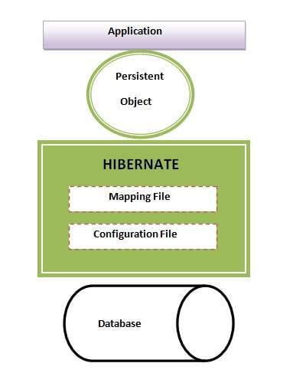
Hibernate Architecture
This is the high level architecture of Hibernate with mapping file and configuration file.

Slide 8
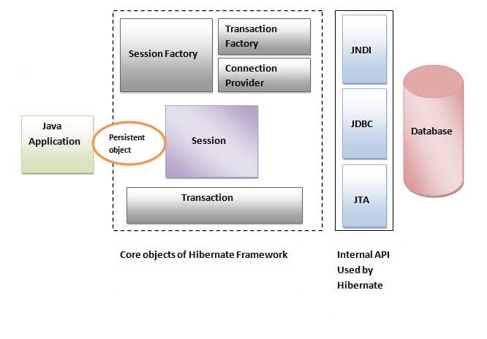
High Level Architecture

Slide 9
Elements of Hibernate Architecture
Hibernate framework uses many objects such as session factory, session, transaction etc. alongwith existing Java API such as JDBC (Java Database Connectivity), JTA (Java Transaction API) and JNDI (Java Naming Directory Interface).
For creating the first hibernate application, we must know the elements of Hibernate architecture. They are as follows:
SessionFactory
The SessionFactory is a factory of session and client of ConnectionProvider. It holds second level cache (optional) of data. The org.hibernate.SessionFactory interface provides factory method to get the object of Session.
Session
The session object provides an interface between the application and data stored in the database. It is a short-lived object and wraps the JDBC connection. It is factory of Transaction, Query and Criteria. It holds a first-level cache (mandatory) of data. The org.hibernate.Session interface provides methods to insert, update and delete the object. It also provides factory methods for Transaction, Query and Criteria.
Transaction
The transaction object specifies the atomic unit of work. It is optional. The org.hibernate.Transaction interface provides methods for transaction management.
ConnectionProvider
It is a factory of JDBC connections. It abstracts the application from DriverManager or DataSource. It is optional.
TransactionFactory
It is a factory of Transaction. It is optional.

Slide 10
First Hibernate Example without IDE
To create the first hibernate application without IDE. For creating the first hibernate application, we need to follow the following steps:
Create the Persistent class
Create the mapping file for Persistent class
Create the Configuration file
Create the class that retrieves or stores the persistent object
Load the jar file
Run the first hibernate application by using command prompt

Slide 11
1) Create the Persistent class
A simple Persistent class should follow some rules:
A no-arg constructor: It is recommended that you have a default constructor at least package visibility so that hibernate can create the instance of the Persistent class by newInstance() method.
Provide an identifier property: It is better to assign an attribute as id. This attribute behaves as a primary key in database.
Declare getter and setter methods: The Hibernate recognizes the method by getter and setter method names by default.
Prefer non-final class: Hibernate uses the concept of proxies, that depends on the persistent class. The application programmer will not be able to use proxies for lazy association fetching.
Let's create the simple Persistent class:
Employee.java
package com.javatpoint.mypackage;
public class Employee {
private int id;
private String firstName,lastName;
public int getId() {
return id;
}
public void setId(int id) {
this.id = id;
}
public String getFirstName() {
return firstName;
}
public void setFirstName(String firstName) {
this.firstName = firstName;
}
public String getLastName() {
return lastName;
}
public void setLastName(String lastName) {
this.lastName = lastName;
}
}

Slide 12
2) Create the mapping file for Persistent class
The mapping file name conventionally, should be class_name.hbm.xml. There are many elements of the mapping file.
hibernate-mapping : It is the root element in the mapping file that contains all the mapping elements.
class : It is the sub-element of the hibernate-mapping element. It specifies the Persistent class.
id : It is the subelement of class. It specifies the primary key attribute in the class.
generator : It is the sub-element of id. It is used to generate the primary key. There are many generator classes such as assigned, increment, hilo, sequence, native etc. We will learn all the generator classes later.
property : It is the sub-element of class that specifies the property name of the Persistent class.

Slide 13
Mapping file
The mapping file for the Employee class:
employee.hbm.xml
<?xml version='1.0' encoding='UTF-8'?>
<!DOCTYPE hibernate-mapping PUBLIC
"-//Hibernate/Hibernate Mapping DTD 5.3//EN"
"http://hibernate.sourceforge.net/hibernate-mapping-5.3.dtd">
<hibernate-mapping>
<class name="com.javatpoint.mypackage.Employee" table="emp1000">
<id name="id">
<generator class="assigned"></generator>
</id>
<property name="firstName"></property>
<property name="lastName"></property>
</class>
</hibernate-mapping>

Slide 14
3) Create the Configuration file
The configuration file contains information about the database and mapping file. Conventionally, its name should be hibernate.cfg.xml .
hibernate.cfg.xml
<?xml version='1.0' encoding='UTF-8'?>
<!DOCTYPE hibernate-configuration PUBLIC
"-//Hibernate/Hibernate Configuration DTD 5.3//EN"
"http://hibernate.sourceforge.net/hibernate-configuration-5.3.dtd">
<hibernate-configuration>
<session-factory>
<property name="hbm2ddl.auto">update</property>
<property name="dialect">org.hibernate.dialect.Oracle9Dialect</property>
<property name="connection.url">jdbc:oracle:thin:@localhost:1521:xe</property>
<property name="connection.username">system</property>
<property name="connection.password">jtp</property>
<property name="connection.driver_class">oracle.jdbc.driver.OracleDriver</property>
<mapping resource="employee.hbm.xml"/>
</session-factory>
</hibernate-configuration>

Slide 15
4) Create the class that retrieves or stores the object
In this class, we are simply storing the employee object to the database.
package com.javatpoint.mypackage;
import org.hibernate.Session;
import org.hibernate.SessionFactory;
import org.hibernate.Transaction;
import org.hibernate.boot.Metadata;
import org.hibernate.boot.MetadataSources;
import org.hibernate.boot.registry.StandardServiceRegistry;
import org.hibernate.boot.registry.StandardServiceRegistryBuilder;
public class StoreData {
public static void main(String[] args) {
//Create typesafe ServiceRegistry object
StandardServiceRegistry ssr = new StandardServiceRegistryBuilder().configure("hibernate.cfg.xml").build();
Metadata meta = new MetadataSources(ssr).getMetadataBuilder().build();
SessionFactory factory = meta.getSessionFactoryBuilder().build();
Session session = factory.openSession();
Transaction t = session.beginTransaction();
Employee e1=new Employee();
e1.setId(101);
e1.setFirstName("Gaurav");
e1.setLastName("Chawla");
session.save(e1);
t.commit();
System.out.println("successfully saved");
factory.close();
session.close();
}
}

Slide 16
5) Load the jar file
For successfully running the hibernate application, you should have the hibernate5.jar file.
Download the required jar files for hibernate

Slide 17
6) How to run the first hibernate application without IDE
We may run this hibernate application by IDE (e.g. Eclipse, Myeclipse, Netbeans etc.) or without IDE. We will learn about creating hibernate application in Eclipse IDE .
To run the hibernate application without IDE:
Install the oracle10g for this example.
Load the jar files for hibernate. (One of the way to load the jar file is copy all the jar files under the JRE/lib/ext folder). It is better to put these jar files inside the public and private JRE both.
Now, run the StoreData class by java com.javatpoint.mypackage.StoreData

Slide 18
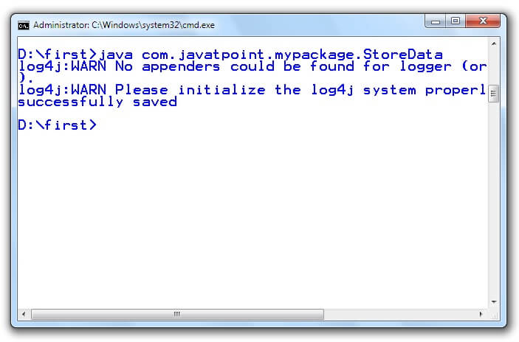
Output

Slide 19
Hibernate Example using XML in Eclipse
Here, we are going to create a simple example of hibernate application using eclipse IDE. For creating the first hibernate application in Eclipse IDE, we need to follow the following steps:
Create the java project
Add jar files for hibernate
Create the Persistent class
Create the mapping file for Persistent class
Create the Configuration file
Create the class that retrieves or stores the persistent object
Run the application

Slide 20
Step 1 & 2
1) Create the java project
Create the java project by File Menu - New - project - java project . Now specify the project name e.g. firsthb then next - finish .
2) Add jar files for hibernate
To add the jar files Right click on your project - Build path - Add external archives. Now select all the jar files as shown in the image given below then click open.
Download the required jar file
In this example, we are connecting the application with oracle database. So you must add the ojdbc14.jar file.
download the ojdbc14.jar file

Slide 21
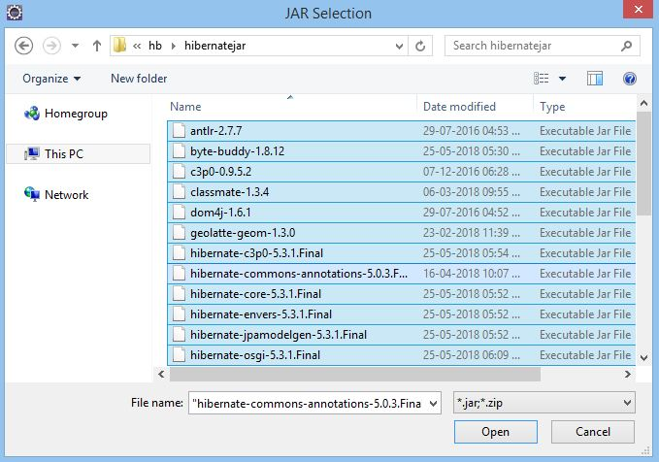
Select JAR file

Slide 22
3) Create the Persistent class
Here, we are creating the same persistent class which we have created in the previous topic. To create the persistent class, Right click on src - New - Class - specify the class with package name (e.g. com.javatpoint.mypackage) - finish .
Employee.java
package com.javatpoint.mypackage;
public class Employee {
private int id;
private String firstName,lastName;
public int getId() {
return id;
}
public void setId(int id) {
this.id = id;
}
public String getFirstName() {
return firstName;
}
public void setFirstName(String firstName) {
this.firstName = firstName;
}
public String getLastName() {
return lastName;
}
public void setLastName(String lastName) {
this.lastName = lastName;
}

Slide 23
4) Create the mapping file for Persistent class
Here, we are creating the same mapping file as created in the previous topic. To create the mapping file, Right click on src - new - file - specify the file name (e.g. employee.hbm.xml) - ok. It must be outside the package.
employee.hbm.xml
<?xml version='1.0' encoding='UTF-8'?>
<!DOCTYPE hibernate-mapping PUBLIC
"-//Hibernate/Hibernate Mapping DTD 5.3//EN"
"http://hibernate.sourceforge.net/hibernate-mapping-5.3.dtd">
<hibernate-mapping>
<class name="com.javatpoint.mypackage.Employee" table="emp1000">
<id name="id">
<generator class="assigned"></generator>
</id>
<property name="firstName"></property>
<property name="lastName"></property>
</class>
</hibernate-mapping>

Slide 24
5) Create the Configuration file
The configuration file contains all the informations for the database such as connection_url, driver_class, username, password etc. The hbm2ddl.auto property is used to create the table in the database automatically. We will have in-depth learning about Dialect class in next topics. To create the configuration file, right click on src - new - file. Now specify the configuration file name e.g. hibernate.cfg.xml.
hibernate.cfg.xml
<?xml version='1.0' encoding='UTF-8'?>
<!DOCTYPE hibernate-configuration PUBLIC
"-//Hibernate/Hibernate Configuration DTD 5.3//EN"
"http://hibernate.sourceforge.net/hibernate-configuration-5.3.dtd">
<hibernate-configuration>
<session-factory>
<property name="hbm2ddl.auto">update</property>
<property name="dialect">org.hibernate.dialect.Oracle9Dialect</property>
<property name="connection.url">jdbc:oracle:thin:@localhost:1521:xe</property>
<property name="connection.username">system</property>
<property name="connection.password">oracle</property>
<property name="connection.driver_class">oracle.jdbc.driver.OracleDriver</property>
<mapping resource="employee.hbm.xml"/>
</session-factory>
</hibernate-configuration>

Slide 25
6) Create the class that retrieves or stores the persistent object
n this class, we are simply storing the employee object to the database.
package com.javatpoint.mypackage;
import org.hibernate.Session;
import org.hibernate.SessionFactory;
import org.hibernate.Transaction;
import org.hibernate.boot.Metadata;
import org.hibernate.boot.MetadataSources;
import org.hibernate.boot.registry.StandardServiceRegistry;
import org.hibernate.boot.registry.StandardServiceRegistryBuilder;
public class StoreData {
public static void main( String[] args )
{
StandardServiceRegistry ssr = new StandardServiceRegistryBuilder().configure("hibernate.cfg.xml").build();
Metadata meta = new MetadataSources(ssr).getMetadataBuilder().build();
SessionFactory factory = meta.getSessionFactoryBuilder().build();
Session session = factory.openSession();
Transaction t = session.beginTransaction();
Employee e1=new Employee();
e1.setId(1);
e1.setFirstName("Gaurav");
e1.setLastName("Chawla");
session.save(e1);
t.commit();
System.out.println("successfully saved");
factory.close();
session.close();
}
}

Slide 26
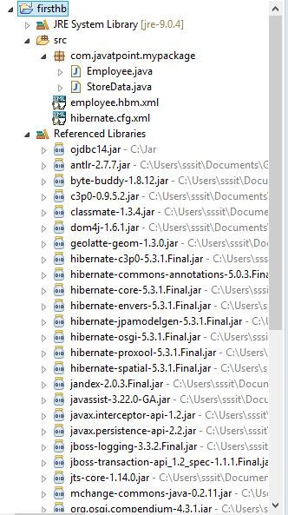
7) Run the application
Before running the application, determine that directory structure is like this.

Slide 27
Hibernate using Anotation
The hibernate application can be created with annotation. There are many annotations that can be used to create hibernate application such as @Entity, @Id, @Table etc.
Hibernate Annotations are based on the JPA 2 specification and supports all the features.
All the JPA annotations are defined in the javax.persistence package. Hibernate EntityManager implements the interfaces and life cycle defined by the JPA specification.
The core advantage of using hibernate annotation is that you don't need to create mapping (hbm) file. Here, hibernate annotations are used to provide the meta data.

Slide 28
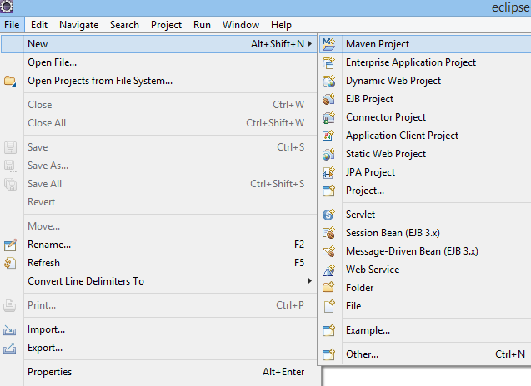
Example to create the hibernate application with Annotation
Here, we are going to create a maven based hibernate application using annotation in eclipse IDE. For creating the hibernate application in Eclipse IDE, we need to follow the below steps:
1) Create the Maven Project
To create the maven project left click on File Menu - New- Maven Project.
The new maven project opens in your eclipse. Click Next.

Slide 29
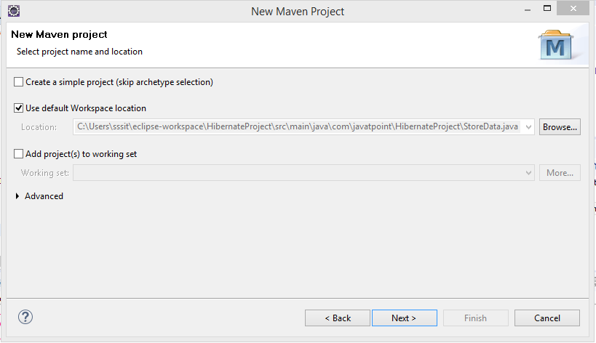
Click Next

Slide 30
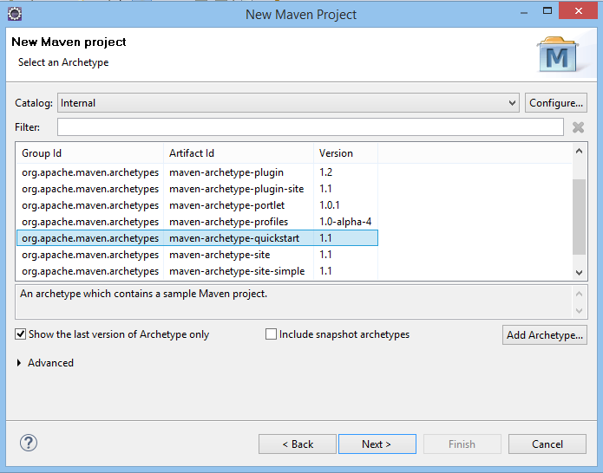
Now, select catalog type: internal and maven archetype - quickstart of 1.1 version. Then, click next.

Slide 31
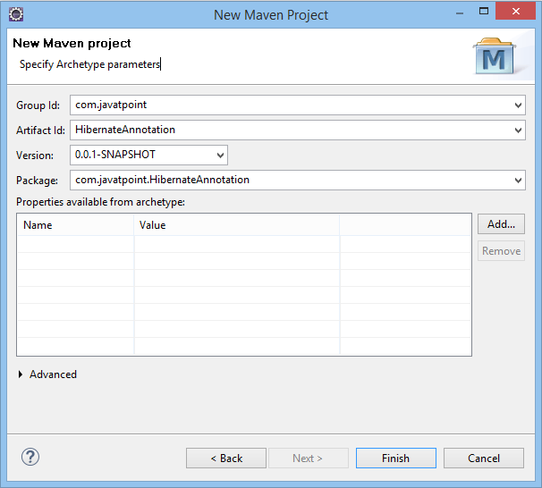
Now, specify the name of Group Id and Artifact Id. The Group Id contains package name (e.g. com.javatpoint) and Artifact Id contains project name (e.g. HibernateAnnotation). Then click Finish.

Slide 32
2) Add project information and configuration in pom.xml file.
Open pom.xml file and click source. Now, add the below dependencies between <dependencies>....</dependencies> tag. These dependencies are used to add the jar files in Maven project.
<dependency>
<groupId>org.hibernate</groupId>
<artifactId>hibernate-core</artifactId>
<version>5.3.1.Final</version>
</dependency>
<dependency>
<groupId>com.oracle</groupId>
<artifactId>ojdbc14</artifactId>
<version>10.2.0.4.0</version>
</dependency>
Due to certain license issues, Oracle drivers are not present in public Maven repository. We can install it manually. To install Oracle driver into your local Maven repository, follow the following steps:
Install Maven
Run the command : install-file -Dfile=Path/to/your/ojdbc14.jar -DgroupId=com.oracle -DartifactId=ojdbc14 -Dversion=12.1.0 -Dpackaging=jar

Slide 33
3) Create the Persistence class.
Here, we are creating the same persistent class which we have created in the previous topic. But here, we are using annotation.
@Entity annotation marks this class as an entity.
@Table annotation specifies the table name where data of this entity is to be persisted. If you don't use @Table annotation, hibernate will use the class name as the table name by default.
@Id annotation marks the identifier for this entity.
@Column annotation specifies the details of the column for this property or field. If @Column annotation is not specified, property name will be used as the column name by default.

Slide 34
To create the Persistence class, right click on src/main/java - New - Class - specify the class name with package - finish.
Employee.java
package com.javatpoint.mypackage;
import javax.persistence.Entity;
import javax.persistence.Id;
import javax.persistence.Table;
@Entity
@Table(name= "emp500")
public class Employee {
@Id
private int id;
private String firstName,lastName;
public int getId() {
return id;
}
public void setId(int id) {
this.id = id;
}
public String getFirstName() {
return firstName;
}
public void setFirstName(String firstName) {
this.firstName = firstName;
}
public String getLastName() {
return lastName;
}
public void setLastName(String lastName) {
this.lastName = lastName;
}
}

Slide 35
4) Create the Configuration file
o create the configuration file, right click on src/main/java - new - file - specify the file name (e.g. hibernate.cfg.xml) - Finish.
hibernate.cfg.xml
<?xml version="1.0" encoding="UTF-8"?>
<!DOCTYPE hibernate-configuration PUBLIC
"-//Hibernate/Hibernate Configuration DTD 5.3//EN"
"http://www.hibernate.org/dtd/hibernate-configuration-5.3.dtd">
<hibernate-configuration>
<session-factory>
<property name="hbm2ddl.auto">update</property>
<property name="dialect">org.hibernate.dialect.Oracle9Dialect</property>
<property name="connection.url">jdbc:oracle:thin:@localhost:1521:xe</property>
<property name="connection.username">system</property>
<property name="connection.password">jtp</property>
<property name="connection.driver_class">oracle.jdbc.driver.OracleDriver</property>
<mapping class="com.javatpoint.mypackage.Employee"/>
</session-factory>
</hibernate-configuration>

Slide 36
5) Create the class that retrieves or stores the persistent object.
StoreData.java
package com.javatpoint.mypackage;
import org.hibernate.Session;
import org.hibernate.SessionFactory;
import org.hibernate.Transaction;
import org.hibernate.boot.Metadata;
import org.hibernate.boot.MetadataSources;
import org.hibernate.boot.registry.StandardServiceRegistry;
import org.hibernate.boot.registry.StandardServiceRegistryBuilder;
public class StoreData {
public static void main(String[] args) {
StandardServiceRegistry ssr = new StandardServiceRegistryBuilder().configure("hibernate.cfg.xml").build();
Metadata meta = new MetadataSources(ssr).getMetadataBuilder().build();
SessionFactory factory = meta.getSessionFactoryBuilder().build();
Session session = factory.openSession();
Transaction t = session.beginTransaction();
Employee e1=new Employee();
e1.setId(101);
e1.setFirstName("Gaurav");
e1.setLastName("Chawla");
session.save(e1);
t.commit();
System.out.println("successfully saved");
factory.close();
session.close();
}
}

Slide 37
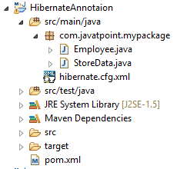
6) Run the application
Before running the application, determine that the directory structure is like this.
To run the hibernate application, right click on the StoreData - Run As - Java Application.

Slide 38
Web Application with Hibernate (using XML)
to create a web application with hibernate. For creating the web application, we are using JSP for presentation logic, Bean class for representing data and DAO class for database codes.
As we create the simple application in hibernate, we don't need to perform any extra operations in hibernate for creating web application. In such case, we are getting the value from the user using the JSP file.

Slide 39
Example to create web application using hibernate
to insert the record of the user in the database. It is simply a registration form.
index.jsp
This page gets input from the user and sends it to the register.jsp file using post method.
<form action="register.jsp" method="post">
Name:<input type="text" name="name"/><br><br/>
Password:<input type="password" name="password"/><br><br/>
Email ID:<input type="text" name="email"/><br><br/>
<input type="submit" value="register"/>"
</form>

Slide 40
register.jsp
his file gets all request parameters and stores this information into an object of User class. Further, it calls the register method of UserDao class passing the User class object.
<%@page import="com.javatpoint.mypack.UserDao"%>
<jsp:useBean id="obj" class="com.javatpoint.mypack.User">
</jsp:useBean>
<jsp:setProperty property="*" name="obj"/>
<%
int i=UserDao.register(obj);
if(i>0)
out.print("You are successfully registered");
%>

Slide 41
User.java
It is the simple bean class representing the Persistent class in hibernate.
package com.javatpoint.mypack;
public class User {
private int id;
private String name,password,email;
//getters and setters
}

Slide 42
user.hbm.xml
It maps the User class with the table of the database.
<?xml version='1.0' encoding='UTF-8'?>
<!DOCTYPE hibernate-mapping PUBLIC
"-//Hibernate/Hibernate Mapping DTD 5.3//EN"
"http://hibernate.sourceforge.net/hibernate-mapping-5.3.dtd">
<hibernate-mapping>
<class name="com.javatpoint.mypack.User" table="u400">
<id name="id">
<generator class="increment"></generator>
</id>
<property name="name"></property>
<property name="password"></property>
<property name="email"></property>
</class>
</hibernate-mapping>

Slide 43
UserDao.java
A Dao class, containing method to store the instance of User class.
package com.javatpoint.mypack;
import org.hibernate.Session;
import org.hibernate.SessionFactory;
import org.hibernate.Transaction;
import org.hibernate.boot.Metadata;
import org.hibernate.boot.MetadataSources;
import org.hibernate.boot.registry.StandardServiceRegistry;
import org.hibernate.boot.registry.StandardServiceRegistryBuilder;
public class UserDao {
public static int register(User u){
int i=0;
StandardServiceRegistry ssr = new StandardServiceRegistryBuilder().configure("hibernate.cfg.xml").build();
Metadata meta = new MetadataSources(ssr).getMetadataBuilder().build();
SessionFactory factory = meta.getSessionFactoryBuilder().build();
Session session = factory.openSession();
Transaction t = session.beginTransaction();
i=(Integer)session.save(u);
t.commit();
session.close();
return i;
}

Slide 44
hibernate.cfg.xml
It is a configuration file, containing informations about the database and mapping file.
<?xml version='1.0' encoding='UTF-8'?>
<!DOCTYPE hibernate-configuration PUBLIC
"-//Hibernate/Hibernate Configuration DTD 5.3//EN"
"http://hibernate.sourceforge.net/hibernate-configuration-5.3.dtd">
<hibernate-configuration>
<session-factory>
<property name="hbm2ddl.auto">create</property>
<property name="dialect">org.hibernate.dialect.Oracle9Dialect</property>
<property name="connection.url">jdbc:oracle:thin:@localhost:1521:xe</property>
<property name="connection.username">system</property>
<property name="connection.password">jtp</property>
<property name="connection.driver_class">oracle.jdbc.driver.OracleDriver</property>
<mapping resource="user.hbm.xml"/>
</session-factory>
</hibernate-configuration>

Slide 45
Generator classes in Hibernate
The <generator> class is a sub-element of id. It is used to generate the unique identifier for the objects of persistent class. There are many generator classes defined in the Hibernate Framework.
All the generator classes implements the org.hibernate.id.IdentifierGenerator interface. The application programmer may create one's own generator classes by implementing the IdentifierGenerator interface. Hibernate framework provides many built-in generator classes:
assigned
increment
sequence
hilo
native
identity
seqhilo
uuid
guid
select
foreign
sequence-identity

Slide 46
SQL Dialects in Hibernate
The dialect specifies the type of database used in hibernate so that hibernate generate appropriate type of SQL statements. For connecting any hibernate application with the database, it is required to provide the configuration of SQL dialect.
Syntax of SQL Dialect
<property name="dialect">org.hibernate.dialect.Oracle9Dialect</property>

Slide 47
List of SQL Dialects/There are many Dialects classes defined for RDBMS in the org.hibernate.dialect package.
RDBMS | Dialect
Oracle (any version) | org.hibernate.dialect.OracleDialect
Oracle9i | org.hibernate.dialect.Oracle9iDialect
Oracle10g | org.hibernate.dialect.Oracle10gDialect
MySQL | org.hibernate.dialect.MySQLDialect
MySQL with InnoDB | org.hibernate.dialect.MySQLInnoDBDialect
MySQL with MyISAM | org.hibernate.dialect.MySQLMyISAMDialect
DB2 | org.hibernate.dialect.DB2Dialect
DB2 AS/400 | org.hibernate.dialect.DB2400Dialect
DB2 OS390 | org.hibernate.dialect.DB2390Dialect
Microsoft SQL Server | org.hibernate.dialect.SQLServerDialect
Sybase | org.hibernate.dialect.SybaseDialect
Sybase Anywhere | org.hibernate.dialect.SybaseAnywhereDialect
PostgreSQL | org.hibernate.dialect.PostgreSQLDialect
SAP DB | org.hibernate.dialect.SAPDBDialect
Informix | org.hibernate.dialect.InformixDialect
HypersonicSQL | org.hibernate.dialect.HSQLDialect
Ingres | org.hibernate.dialect.IngresDialect
Progress | org.hibernate.dialect.ProgressDialect
Mckoi SQL | org.hibernate.dialect.MckoiDialect
Interbase | org.hibernate.dialect.InterbaseDialect
Pointbase | org.hibernate.dialect.PointbaseDialect
FrontBase | org.hibernate.dialect.FrontbaseDialect
Firebird | org.hibernate.dialect.FirebirdDialect

Slide 48
Hibernate with Eclipse
to create a simple example of hibernate application using eclipse IDE. For creating the first hibernate application in Eclipse IDE, we need to follow the following steps:
Create the java project
Add jar files for hibernate
Create the Persistent class
Create the mapping file for Persistent class
Create the Configuration file
Create the class that retrieves or stores the persistent object
Run the application

Slide 49
Step 1 & 2
1) Create the java project
Create the java project by File Menu - New - project - java project . Now specify the project name e.g. firsthb then next - finish .
2) Add jar files for hibernate
To add the jar files Right click on your project - Build path - Add external archives. Now select all the jar files as shown in the image given below then click open.

Slide 50
In this example, we are connecting the application with oracle database. So you must add the ojdbc14.jar file.

Slide 51
3) Create the Persistent class
creating the same persistent class which we have created in the previous topic. To create the persistent class, Right click on src - New - Class - specify the class with package name (e.g. com.javatpoint.mypackage) - finish .
Employee.java
package com.javatpoint.mypackage;
public class Employee {
private int id;
private String firstName,lastName;
public int getId() {
return id;
}
public void setId(int id) {
this.id = id;
}
public String getFirstName() {
return firstName;
}
public void setFirstName(String firstName) {
this.firstName = firstName;
}
public String getLastName() {
return lastName;
}
public void setLastName(String lastName) {
this.lastName = lastName;
}
}

Slide 52
4) Create the mapping file for Persistent class
creating the same mapping file as created in the previous topic. To create the mapping file, Right click on src - new - file - specify the file name (e.g. employee.hbm.xml) - ok. It must be outside the package.
employee.hbm.xml
<?xml version='1.0' encoding='UTF-8'?>
<!DOCTYPE hibernate-mapping PUBLIC
"-//Hibernate/Hibernate Mapping DTD 5.3//EN"
"http://hibernate.sourceforge.net/hibernate-mapping-5.3.dtd">
<hibernate-mapping>
<class name="com.javatpoint.mypackage.Employee" table="emp1000">
<id name="id">
<generator class="assigned"></generator>
</id>
<property name="firstName"></property>
<property name="lastName"></property>
</class>
</hibernate-mapping>

Slide 53
5) Create the Configuration file
The configuration file contains all the informations for the database such as connection_url, driver_class, username, password etc. The hbm2ddl.auto property is used to create the table in the database automatically. We will have in-depth learning about Dialect class in next topics. To create the configuration file, right click on src - new - file. Now specify the configuration file name e.g. hibernate.cfg.xml.
hibernate.cfg.xml
<?xml version='1.0' encoding='UTF-8'?>
<!DOCTYPE hibernate-configuration PUBLIC
"-//Hibernate/Hibernate Configuration DTD 5.3//EN"
"http://hibernate.sourceforge.net/hibernate-configuration-5.3.dtd">
<hibernate-configuration>
<session-factory>
<property name="hbm2ddl.auto">update</property>
<property name="dialect">org.hibernate.dialect.Oracle9Dialect</property>
<property name="connection.url">jdbc:oracle:thin:@localhost:1521:xe</property>
<property name="connection.username">system</property>
<property name="connection.password">oracle</property>
<property name="connection.driver_class">oracle.jdbc.driver.OracleDriver</property>
<mapping resource="employee.hbm.xml"/>
</session-factory>
</hibernate-configuration>

Slide 54
6) Create the class that retrieves or stores the persistent object
simply storing the employee object to the database.
package com.javatpoint.mypackage;
import org.hibernate.Session;
import org.hibernate.SessionFactory;
import org.hibernate.Transaction;
import org.hibernate.boot.Metadata;
import org.hibernate.boot.MetadataSources;
import org.hibernate.boot.registry.StandardServiceRegistry;
import org.hibernate.boot.registry.StandardServiceRegistryBuilder;
public class StoreData {
public static void main( String[] args )
{
StandardServiceRegistry ssr = new StandardServiceRegistryBuilder().configure("hibernate.cfg.xml").build();
Metadata meta = new MetadataSources(ssr).getMetadataBuilder().build();
SessionFactory factory = meta.getSessionFactoryBuilder().build();
Session session = factory.openSession();
Transaction t = session.beginTransaction();
Employee e1=new Employee();
e1.setId(1);
e1.setFirstName("Gaurav");
e1.setLastName("Chawla");
session.save(e1);
t.commit();
System.out.println("successfully saved");
factory.close();
session.close();
}
}

Slide 55
7) Run the application
Before running the application, determine that directory structure is like this

Slide 56
Web Application with Hibernate (using XML)
to create a web application with hibernate. For creating the web application, we are using JSP for presentation logic, Bean class for representing data and DAO class for database codes.
As we create the simple application in hibernate, we don't need to perform any extra operations in hibernate for creating web application. In such case, we are getting the value from the user using the JSP file.

Slide 57
Example to create web application using hibernate
to insert the record of the user in the database. It is simply a registration form.
index.jsp
This page gets input from the user and sends it to the register.jsp file using post method.
<form action="register.jsp" method="post">
Name:<input type="text" name="name"/><br><br/>
Password:<input type="password" name="password"/><br><br/>
Email ID:<input type="text" name="email"/><br><br/>
<input type="submit" value="register"/>"
</form>

Slide 58
register.jsp
This file gets all request parameters and stores this information into an object of User class. Further, it calls the register method of UserDao class passing the User class object.
<%@page import="com.javatpoint.mypack.UserDao"%>
<jsp:useBean id="obj" class="com.javatpoint.mypack.User">
</jsp:useBean>
<jsp:setProperty property="*" name="obj"/>
<%
int i=UserDao.register(obj);
if(i>0)
out.print("You are successfully registered");
%>

Slide 59
User.java
It is the simple bean class representing the Persistent class in hibernate.
package com.javatpoint.mypack;
public class User {
private int id;
private String name,password,email;
//getters and setters
}

Slide 60
user.hbm.xml
It maps the User class with the table of the database.
<?xml version='1.0' encoding='UTF-8'?>
<!DOCTYPE hibernate-mapping PUBLIC
"-//Hibernate/Hibernate Mapping DTD 5.3//EN"
"http://hibernate.sourceforge.net/hibernate-mapping-5.3.dtd">
<hibernate-mapping>
<class name="com.javatpoint.mypack.User" table="u400">
<id name="id">
<generator class="increment"></generator>
</id>
<property name="name"></property>
<property name="password"></property>
<property name="email"></property>
</class>
</hibernate-mapping>

Slide 61
UserDao.java
A Dao class, containing method to store the instance of User class.
package com.javatpoint.mypack;
import org.hibernate.Session;
import org.hibernate.SessionFactory;
import org.hibernate.Transaction;
import org.hibernate.boot.Metadata;
import org.hibernate.boot.MetadataSources;
import org.hibernate.boot.registry.StandardServiceRegistry;
import org.hibernate.boot.registry.StandardServiceRegistryBuilder;
public class UserDao {
public static int register(User u){
int i=0;
StandardServiceRegistry ssr = new StandardServiceRegistryBuilder().configure("hibernate.cfg.xml").build();
Metadata meta = new MetadataSources(ssr).getMetadataBuilder().build();
SessionFactory factory = meta.getSessionFactoryBuilder().build();
Session session = factory.openSession();
Transaction t = session.beginTransaction();
i=(Integer)session.save(u);
t.commit();
session.close();
return i;
}
}

Slide 62
hibernate.cfg.xml
It is a configuration file, containing informations about the database and mapping file.
<?xml version='1.0' encoding='UTF-8'?>
<!DOCTYPE hibernate-configuration PUBLIC
"-//Hibernate/Hibernate Configuration DTD 5.3//EN"
"http://hibernate.sourceforge.net/hibernate-configuration-5.3.dtd">
<hibernate-configuration>
<session-factory>
<property name="hbm2ddl.auto">create</property>
<property name="dialect">org.hibernate.dialect.Oracle9Dialect</property>
<property name="connection.url">jdbc:oracle:thin:@localhost:1521:xe</property>
<property name="connection.username">system</property>
<property name="connection.password">jtp</property>
<property name="connection.driver_class">oracle.jdbc.driver.OracleDriver</property>
<mapping resource="user.hbm.xml"/>
</session-factory>
</hibernate-configuration>

Slide 63
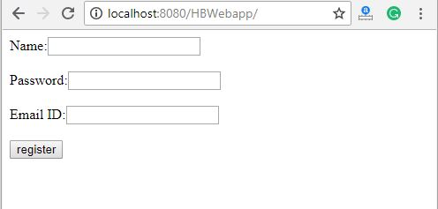
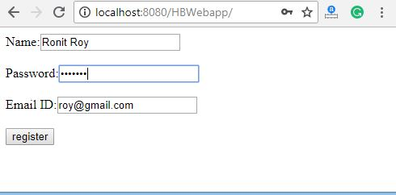
Output

Slide 64
Querying - HQL
Hibernate Query Language (HQL) is same as SQL (Structured Query Language) but it doesn't depends on the table of the database.
Instead of table name, use class name in HQL. So it is database independent query language.
Advantage of HQL
database independent
supports polymorphic queries
easy to learn for Java Programmer

Slide 65
Query Interface
It is an object oriented representation of Hibernate Query.
The object of Query can be obtained by calling the createQuery() method Session interface.
Commonly used methods
public int executeUpdate() is used to execute the update or delete query.
public List list() returns the result of the ralation as a list.
public Query setFirstResult(int rowno) specifies the row number from where record will be retrieved.
public Query setMaxResult(int rowno) specifies the no. of records to be retrieved from the relation (table).
public Query setParameter(int position, Object value) it sets the value to the JDBC style query parameter.
public Query setParameter(String name, Object value) it sets the value to a named query parameter.

Slide 66
Example
Example of HQL to get all the records
Query query=session.createQuery("from Emp");//here persistent class name is Emp
List list=query.list();
Example of HQL to get records with pagination
Query query=session.createQuery("from Emp");
query.setFirstResult(5);
query.setMaxResult(10);
List list=query.list();//will return the records from 5 to 10th number

Slide 67
Example
Example of HQL update query
Transaction tx=session.beginTransaction();
Query q=session.createQuery("update User set name=:n where id=:i");
q.setParameter("n","Udit Kumar");
q.setParameter("i",111);
int status=q.executeUpdate();
System.out.println(status);
tx.commit();

Slide 68
Example
Example of HQL delete query
Query query=session.createQuery("delete from Emp where id=100"); //specifying class name (Emp) not tablename
query.executeUpdate();
HQL with Aggregate functions
call avg(), min(), max() etc. aggregate functions by HQL.

Slide 69
Example
Example to get total salary of all the employees
Query q=session.createQuery("select sum(salary) from Emp");
List<Integer> list=q.list();
System.out.println(list.get(0));
Example to get maximum salary of employee
Query q=session.createQuery("select max(salary) from Emp");
Example to get minimum salary of employee
Query q=session.createQuery("select min(salary) from Emp");
Example to count total number of employee ID
Query q=session.createQuery("select count(id) from Emp");
Example to get average salary of each employees
Query q=session.createQuery("select avg(salary) from Emp");

Slide 70
HCQL (Hibernate Criteria Query Language)
The Hibernate Criteria Query Language (HCQL) is used to fetch the records based on the specific criteria. The Criteria interface provides methods to apply criteria such as retreiving all the records of table whose salary is greater than 50000 etc.
Advantage of HCQL
The HCQL provides methods to add criteria, so it is easy for the java programmer to add criteria. The java programmer is able to add many criteria on a query.

Slide 71
Criteria Interface
The Criteria interface provides many methods to specify criteria. The object of Criteria can be obtained by calling the createCriteria() method of Session interface.
Syntax of createCriteria() method of Session interface
public Criteria createCriteria(Class c)
The commonly used methods of Criteria interface are as follows:
public Criteria add(Criterion c) is used to add restrictions.
public Criteria addOrder(Order o) specifies ordering.
public Criteria setFirstResult(int firstResult) specifies the first number of record to be retreived.
public Criteria setMaxResult(int totalResult) specifies the total number of records to be retreived.
public List list() returns list containing object.
public Criteria setProjection(Projection projection) specifies the projection.

Slide 72
Restrictions class
Restrictions class provides methods that can be used as Criterion. The commonly used methods of Restrictions class are as follows:
public static SimpleExpression lt(String propertyName,Object value) sets the less than constraint to the given property.
public static SimpleExpression le(String propertyName,Object value) sets the less than or equal constraint to the given property.
public static SimpleExpression gt(String propertyName,Object value) sets the greater than constraint to the given property.
public static SimpleExpression ge(String propertyName,Object value) sets the greater than or equal than constraint to the given property.
public static SimpleExpression ne(String propertyName,Object value) sets the not equal constraint to the given property.
public static SimpleExpression eq(String propertyName,Object value) sets the equal constraint to the given property.
public static Criterion between(String propertyName, Object low, Object high) sets the between constraint.
public static SimpleExpression like(String propertyName, Object value) sets the like constraint to the given property.

Slide 73
Order class
The Order class represents an order. The commonly used methods of Restrictions class are as follows:
public static Order asc(String propertyName) applies the ascending order on the basis of given property.
public static Order desc(String propertyName) applies the descending order on the basis of given property.

Slide 74
Examples
Example of HCQL to get all the records
Crietria c=session.createCriteria(Emp.class);//passing Class class argument
List list=c.list();
Example of HCQL to get the 10th to 20th record
Crietria c=session.createCriteria(Emp.class);
c.setFirstResult(10);
c.setMaxResult(20);
List list=c.list();
Example of HCQL to get the records whose salary is greater than 10000
Crietria c=session.createCriteria(Emp.class);
c.add(Restrictions.gt("salary",10000));//salary is the propertyname
List list=c.list();
Example of HCQL to get the records in ascending order on the basis of salary
Crietria c=session.createCriteria(Emp.class);
c.addOrder(Order.asc("salary"));
List list=c.list();

Slide 75
HCQL with Projection
fetch data of a particular column by projection such as name etc. Let's see the simple example of projection that prints data of NAME column of the table only.
Criteria c=session.createCriteria(Emp.class);
c.setProjection(Projections.property("name"));
List list=c.list();

Slide 76
Hibernate Named Query
The hibernate named query is way to use any query by some meaningful name. It is like using alias names. The Hibernate framework provides the concept of named queries so that application programmer need not to scatter queries to all the java code.
There are two ways to define the named query in hibernate:
by annotation
by mapping file.

Slide 77
Hibernate Named Query by annotation
to use named query in hibernate, you need to have knowledge of @NamedQueries and @NamedQuery annotations.
@NameQueries annotation is used to define the multiple named queries.
@NameQuery annotation is used to define the single named query.
Let's see the example of using the named queries:
@NamedQueries(
{
@NamedQuery(
name = "findEmployeeByName",
query = "from Employee e where e.name = :name"
)
}
)

Slide 78
Example of Hibernate Named Query by annotation
In this example, we are using annotations to defined the named query in the persistent class. There are three files only:
Employee.java
hibernate.cfg.xml
FetchDemo
In this example, we are assuming that there is em table in the database containing 4 columns id, name, job and salary and there are some records in this table.

Slide 79
Employee.java
It is a persistent class that uses annotations to define named query and marks this class as entity.
package com.javatpoint;
import javax.persistence.*;
import javax.persistence.Entity;
import javax.persistence.GeneratedValue;
import javax.persistence.Id;
@NamedQueries(
{
@NamedQuery(
name = "findEmployeeByName",
query = "from Employee e where e.name = :name"
)
}
)
@Entity
@Table(name="em")
public class Employee {
public String toString(){return id+" "+name+" "+salary+" "+job;}
int id;
String name;
int salary;
String job;
@Id
@GeneratedValue(strategy=GenerationType.AUTO)
//getters and setters
}

Slide 80
hibernate.cfg.xml
It is a configuration file that stores the informations about database such as driver class, url, username, password and mapping class etc.
<?xml version='1.0' encoding='UTF-8'?>
<!DOCTYPE hibernate-configuration PUBLIC
"-//Hibernate/Hibernate Configuration DTD 5.3//EN"
"http://hibernate.sourceforge.net/hibernate-configuration-5.3.dtd">
<hibernate-configuration>
<session-factory>
<property name="hbm2ddl.auto">update</property>
<property name="dialect">org.hibernate.dialect.Oracle9Dialect</property>
<property name="connection.url">jdbc:oracle:thin:@localhost:1521:xe</property>
<property name="connection.username">system</property>
<property name="connection.password">jtp</property>
<property name="connection.driver_class">oracle.jdbc.driver.OracleDriver</property>
<mapping class="com.javatpoint.Employee"/>
</session-factory>
</hibernate-configuration>

Slide 81
FetchData.java
It is a java class that uses the named query and prints the informations based on the query. The getNamedQuery method uses the named query and returns the instance of Query.
package com.javatpoint;
import java.util.*;
import javax.persistence.*;
import org.hibernate.*;
import org.hibernate.boot.Metadata;
import org.hibernate.boot.MetadataSources;
import org.hibernate.boot.registry.StandardServiceRegistry;
import org.hibernate.boot.registry.StandardServiceRegistryBuilder;
public class Fetch {
public static void main(String[] args) {
StandardServiceRegistry ssr=new StandardServiceRegistryBuilder().configure("hibernate.cfg.xml").build();
Metadata meta=new MetadataSources(ssr).getMetadataBuilder().build();
SessionFactory factory=meta.getSessionFactoryBuilder().build();
Session session=factory.openSession();
//Hibernate Named Query
TypedQuery query = session.getNamedQuery("findEmployeeByName");
query.setParameter("name","amit");
List<Employee> employees=query.getResultList();
Iterator<Employee> itr=employees.iterator();
while(itr.hasNext()){
Employee e=itr.next();
System.out.println(e);
}
session.close();
}
}

Slide 82
Hibernate Named Query by mapping file
If want to define named query by mapping file, you need to use query element of hibernate-mapping to define the named query.
In such case, you need to create hbm file that defines the named query. Other resources are same as given in the above example except Persistent class Employee.java where you don't need to use any annotation and hibernate.cfg.xml file where you need to specify mapping resource of the hbm file.

Slide 83
emp.hbm.xml
<?xml version='1.0' encoding='UTF-8'?>
<!DOCTYPE hibernate-mapping PUBLIC
"-//Hibernate/Hibernate Mapping DTD 5.3//EN"
"http://hibernate.sourceforge.net/hibernate-mapping-5.3.dtd">
<hibernate-mapping>
<class name="com.javatpoint.Employee" table="em">
<id name="id">
<generator class="native"></generator>
</id>
<property name="name"></property>
<property name="job"></property>
<property name="salary"></property>
</class>
<query name="findEmployeeByName">
<![CDATA[from Employee e where e.name = :name]]>
</query>
</hibernate-mapping>

Slide 84
The persistent class-Employee.java
package com.javatpoint;
public class Employee {
int id;
String name;
int salary;
String job;
//getters and setters
}

Slide 85
mapping resource in the hbm file as:
include the mapping resource in the hbm file as:
hibernate.cfg.xml
<mapping resource="emp.hbm.xml"/>

Slide 86
Caching in Hibernate
Hibernate caching improves the performance of the application by pooling the object in the cache. It is useful when we have to fetch the same data multiple times.
There are mainly two types of caching:
First Level Cache, and
Second Level Cache

Slide 87
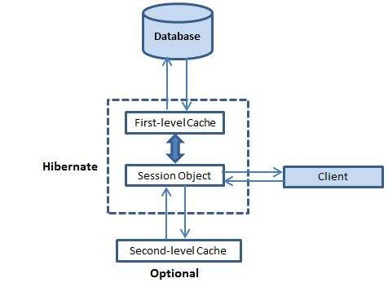
multilevel caching scheme

Slide 88
First Level Cache/ Session cache
Session object holds the first level cache data. It is enabled by default. The first level cache data will not be available to entire application. An application can use many session object.
a mandatory cache through which all requests must pass. The Session object keeps an object under its own power before committing it to the database.
If you issue multiple updates to an object, Hibernate tries to delay doing the update as long as possible to reduce the number of update SQL statements issued. If you close the session, all the objects being cached are lost and either persisted or updated in the database.

Slide 89
Second Level Cache
Hibernate uses first-level cache by default and you have nothing to do to use first-level cache. Let's go straight to the optional second-level cache. Not all classes benefit from caching, so it's important to be able to disable the second-level cache
SessionFactory object holds the second level cache data. The data stored in the second level cache will be available to entire application. But we need to enable it explicitely.
Hibernate second level cache uses a common cache for all the session object of a session factory. It is useful if you have multiple session objects from a session factory.
SessionFactory holds the second level cache data. It is global for all the session objects and not enabled by default.

Slide 90
Cache Provider
Provider | Description
EHCache | It can cache in memory or on disk and clustered caching and it supports the optional Hibernate query result cache
OSCache | Supports caching to memory and disk in a single JVM with a rich set of expiration policies and query cache support.
warmCache | A cluster cache based on JGroups. It uses clustered invalidation, but doesn't support the Hibernate query cache.
JBoss Cache | A fully transactional replicated clustered cache also based on the JGroups multicast library. It supports replication or invalidation, synchronous or asynchronous communication, and optimistic and pessimistic locking. The Hibernate query cache is supported.

Slide 91
Performance and Concurrency Strategies
A concurrency strategy is a mediator, which is responsible for storing items of data in the cache and retrieving them from the cache.
Strategy | Usuage
read-only | caching will work for read only operation. suitable for data, which never changes. Use it for reference data only.
read-write | caching will work for read and write, can be used simultaneously. it is critical to prevent stale data in concurrent transactions, in the rare case of an update.
nonstrict-read-write | caching will work for read and write but one at a time. no guarantee of consistency between the cache and the database. Use this strategy if data hardly ever changes and a small likelihood of stale data is not of critical concern.
Transactional | caching will work for transaction. for read-mostly data where it is critical to prevent stale data in concurrent transactions, in the rare case of an update.

Slide 92
compatibility matrix
Implementation | read-only | nonstrict-read-write | read-write | transactional
EH Cache | Yes | Yes | Yes | No
OS Cache | Yes | Yes | Yes | No
Swarm Cache | Yes | Yes | No | No
JBoss Cache | No | No | No | Y

Slide 93
Hibernate – Batch Fetching
if application need to navigate the association to retrieve associated objects Hibernate uses a fetching strategy
Batch fetching is an optimization of the lazy select fetching strategy. There are two ways you can configure batch fetching: on the class level and the collection level.
In the O/R mapping metadata, or over-ridden by a particular HQL or Criteria query strategies can be declared. In hibernate their are four fetching strategies. 1.fetch "select" (default) - Lazy load all the collections and entities. 2.fetch "join" - always load all the collections and entities and Disable the lazy loading 3.batch size="N" - Fetching up to 'N' collections or entities 4.fetch "subselect" = Group its collection into a sub select statement.

Slide 94
Gap

Slide 95
JPA – Java Persistent API
a specification of Java.
It is used to persist data between Java object and relational database.
JPA acts as a bridge between object-oriented domain models and relational database systems.
it doesn't perform any operation by itself. It requires an implementation. So, ORM tools like Hibernate, TopLink and iBatis implements JPA specifications for data persistence.

Slide 96
JPA Versions
JPA 1.0 was released in 2006 as a part of EJB 3.0 specification.
JPA 2.0 - This version was released in the last of 2009. Following are the important features of this version: -
It supports validation.
It expands the functionality of object-relational mapping.
It shares the object of cache support.
JPA 2.1 - The JPA 2.1 was released in 2013 with the following features: -
It allows fetching of objects.
It provides support for criteria update/delete.
It generates schema.
JPA 2.2 - The JPA 2.2 was released as a development of maintainenece in 2017. Some of its important feature are: -
It supports Java 8 Date and Time.
It provides @Repeatable annotation that can be used when we want to apply the same annotations to a declaration or type use.
It allows JPA annotation to be used in meta-annotations.
It provides an ability to stream a query result.

Slide 97
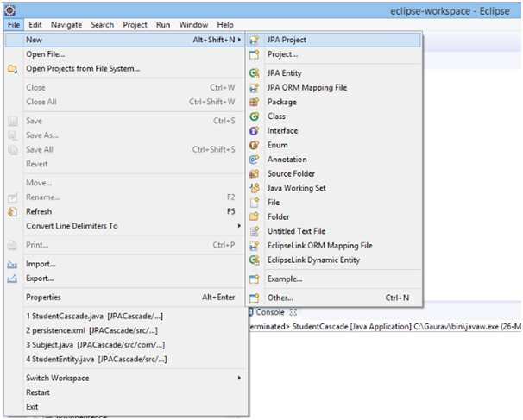
JPA Installation
Open eclipse and click on File>New>JPA Project.

Slide 98
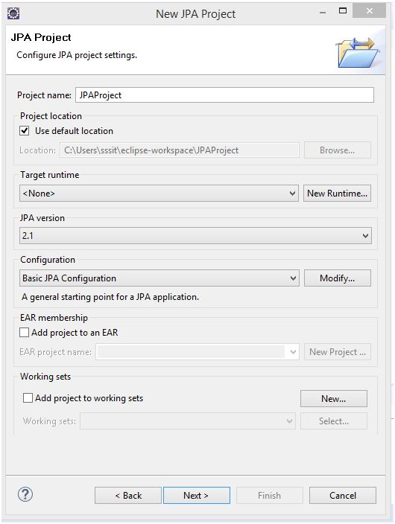
JPA Installation
Specify any particular project name (here, we named JPAProject) and click next.

Slide 99
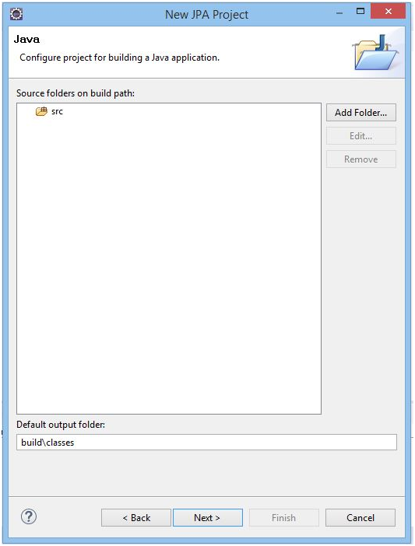
JPA Installation
Again, click next.

Slide 100
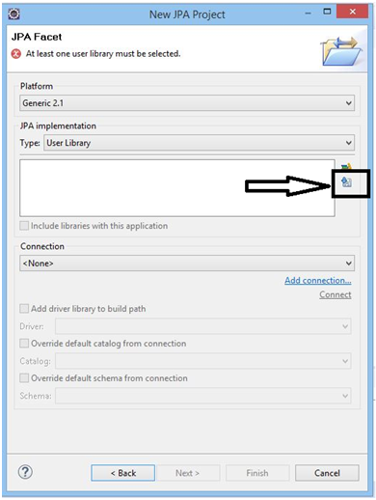
JPA Installation
Click on download library icon (here, enclosed within black box).

Slide 101
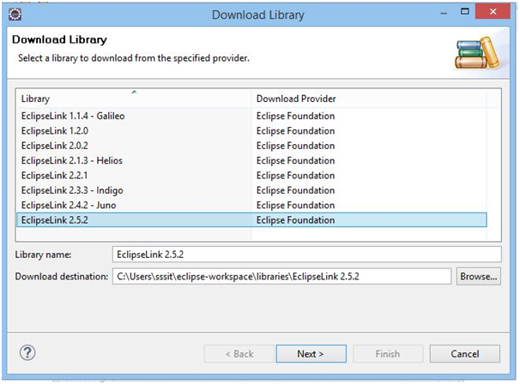
JPA Installation
Click on EclipseLink 2.5.2 and then next.

Slide 102
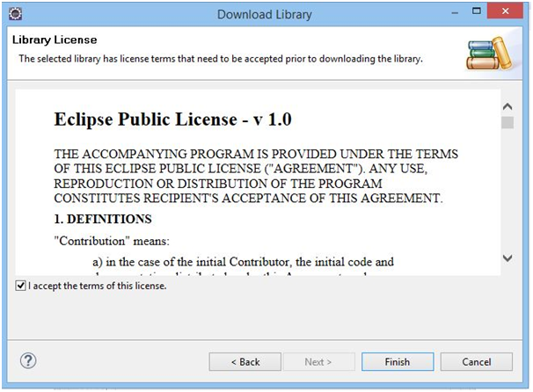
JPA Installation
Click on checkbox to accept the terms and then click finish. After that all the required jars will be downloaded.

Slide 103
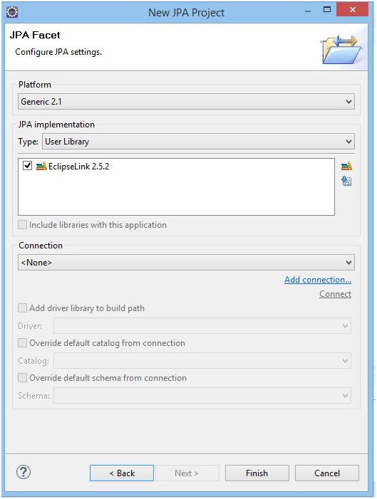
JPA Installation
Now,click finish.

Slide 104
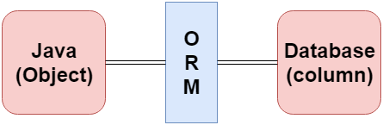
JPA – ORM(Object Relational Mapping)
Object Relational Mapping (ORM) is a functionality which is used to develop and maintain a relationship between an object and relational database by mapping an object state to database column. It is capable to handle various database operations easily such as inserting, updating, deleting etc.

Slide 105
ORM Frameworks
the various frameworks that function on ORM mechanism: -
Hibernate
TopLink
ORMLite
iBATIS
JPOX

Slide 106
Mapping Directions
Mapping Directions are divided into two parts: -
Unidirectional relationship - In this relationship, only one entity can refer the properties to another. It contains only one owing side that specifies how an update can be made in the database.
Bidirectional relationship - This relationship contains an owning side as well as an inverse side. So here every entity has a relationship field or refer the property to other entity.

Slide 107
Types of Mapping
One-to-one - This association is represented by @OneToOne annotation. Here, instance of each entity is related to a single instance of another entity.
One-to-many - This association is represented by @OneToMany annotation. In this relationship, an instance of one entity can be related to more than one instance of another entity.
Many-to-one - This mapping is defined by @ManyToOne annotation. In this relationship, multiple instances of an entity can be related to single instance of another entity.
Many-to-many - This association is represented by @ManyToMany annotation. Here, multiple instances of an entity can be related to multiple instances of another entity. In this mapping, any side can be the owing side.

Slide 108
JPA Entity
entity is a group of states associated together in a single unit.
On adding behaviour, an entity behaves as an object and becomes a major constituent of object-oriented paradigm.
So, an entity is an application-defined object in Java Persistence Library.

Slide 109
Entity Properties
the properties of an entity that an object must have: -
Persistability - An object is called persistent if it is stored in the database and can be accessed anytime.
Persistent Identity - In Java, each entity is unique and represents as an object identity. Similarly, when the object identity is stored in a database then it is represented as persistence identity. This object identity is equivalent to primary key in database.
Transactionality - Entity can perform various operations such as create, delete, update. Each operation makes some changes in the database. It ensures that whatever changes made in the database either be succeed or failed atomically.
Granuality - Entities should not be primitives, primitive wrappers or built-in objects with single dimensional state.

Slide 110
Entity Metadata
Each entity is associated with some metadata that represents the information of it. Instead of database, this metadata is exist either inside or outside the class. This metadata can be in following forms: -
Annotation - In Java, annotations are the form of tags that represents metadata. This metadata persist inside the class.
XML - In this form, metadata persist outside the class in XML file.

Slide 111
JPA Creating an Entity
A Java class can be easily transformed into an entity. For transformation the basic requirements are: -
No-argument Constructor
Annotation
to transform a regular Java class into an entity class with the help of an example: -
Simple Student class
public class Student {
private int id;
private String name;
private long fees;
public Student() {}
public Student(int id)
{
this.id = id;
}
public int getId()
{
return id;
}
public void setId(int id)
{
this.id = id;
}
public String getName()
{
return name;
}
public void setName(String name)
{
this.name = name;
}
public long getFees()
{
return fees;
}
public void setFees (long fees)
{
this.fees = fees;
}
}

Slide 112
Above class is a regular java class having three attributes id, name and fees. To transform this class into an entity add @Entity and @Id annotation in it.
@Entity - This is a marker annotation which indicates that this class is an entity. This annotation must be placed on the class name.
@Id - This annotation is placed on a specific field that holds the persistent identifying properties. This field is treated as a primary key in database.
Simple Entity Class
import javax.persistence.*;
@Entity
public class Student {
@Id
private int id;
private String name;
private long fees;
public Student() {}
public Student(int id)
{
this.id = id;
}
public int getId()
{
return id;
}
public void setId(int id)
{
this.id = id;
}
public String getName()
{
return name;
}
public void setName(String name)
{
this.name = name;
}
public long getFees()
{
return fees;
}
public void setFees (long fees)
{
this.fees = fees;
}
}

Slide 113
JPA Entity Manager
roles of an entity manager:
The entity manager implements the API and encapsulates all of them within a single interface.
Entity manager is used to read, delete and write an entity.
An object referenced by an entity is managed by entity manager.

Slide 114
Steps to persist an entity object.
1) Creating an entity manager factory object
The EntityManagerFactory interface present in java.persistence package is used to provide an entity manager.
EntityManagerFactory emf=Persistence.createEntityManagerFactory("Student_details");
Persistence - The Persistence is a bootstrap class which is used to obtain an EntityManagerFactory interface.
createEntityManagerFactory() method - The role of this method is to create and return an EntityManagerFactory for the named persistence unit. Thus, this method contains the name of persistence unit passed in the Persistence.xml file.

Slide 115
Step
2) Obtaining an entity manager from factory.
EntityManager em=emf.createEntityManager();
EntityManager - An EntityManager is an interface
createEntityManager() method - It creates new application-managed EntityManager
3) Intializing an entity manager.
em.getTransaction().begin();
getTransaction() method - This method returns the resource-level EntityTransaction object.
begin() method - This method is used to start the transaction.

Slide 116
Step
4) Persisting a data into relational database.
em.persist(s1);
persist() - This method is used to make an instance managed and persistent. An entity instance is passed within this method.
5) Closing the transaction
em.getTransaction().commit();
6) Releasing the factory resources.
emf.close();
em.close();
close() - This method is used to releasing the factory resources.

Slide 117
Entity Operations
Inserting an Entity
Finding an Entity
Updating an Entity
Deleting an Entity

Slide 118
Inserting an Entity
In JPA, we can easily insert data into database through entities. The EntityManager provides persist() method to insert records.
JPA Entity Insertion Example
Here, we will insert the record of students.
This example contains the following steps: -
Create an entity class named as StudentEntity.java under com.javatpoint.jpa.student package that contains attributes s_id, s_name, s_age.

Slide 119
StudentEntity.java
package com.javatpoint.jpa.student;
import javax.persistence.*;
@Entity
@Table(name="student")
public class StudentEntity {
@Id
private int s_id;
private String s_name;
private int s_age;
public StudentEntity(int s_id, String s_name, int s_age) {
super();
this.s_id = s_id;
this.s_name = s_name;
this.s_age = s_age;
}
public StudentEntity() {
super();
}
public int getS_id() {
return s_id;
}
public void setS_id(int s_id) {
this.s_id = s_id;
}
public String getS_name() {
return s_name;
}
public void setS_name(String s_name) {
this.s_name = s_name;
}
public int getS_age() {
return s_age;
}
public void setS_age(int s_age) {
this.s_age = s_age;
}
}

Slide 120
Persistence.xml
Now, map the entity class and other databases confiuguration in Persistence.xml file.
<persistence>
<persistence-unit name="Student_details">
<class>com.javatpoint.jpa.student.StudentEntity</class>
<properties>
<property name="javax.persistence.jdbc.driver" value="com.mysql.jdbc.Driver"/>
<property name="javax.persistence.jdbc.url" value="jdbc:mysql://localhost:3306/studentdata"/>
<property name="javax.persistence.jdbc.user" value="root"/>
<property name="javax.persistence.jdbc.password" value=""/>
<property name="eclipselink.logging.level" value="SEVERE"/>
<property name="eclipselink.ddl-generation" value="create-or-extend-tables"/>
</properties>
</persistence-unit>
</persistence>

Slide 121
PersistStudent.java
Create a persistence class named as PersistStudent.java under com.javatpoint.jpa.persist package to persist the entity object with data.
package com.javatpoint.jpa.persist;
import com.javatpoint.jpa.student.*;
import javax.persistence.*;
public class PersistStudent {
public static void main(String args[])
{
EntityManagerFactory emf=Persistence.createEntityManagerFactory("Student_details");
EntityManager em=emf.createEntityManager();
em.getTransaction().begin();
StudentEntity s1=new StudentEntity();
s1.setS_id(101);
s1.setS_name("Gaurav");
s1.setS_age(24);
StudentEntity s2=new StudentEntity();
s2.setS_id(102);
s2.setS_name("Ronit");
s2.setS_age(22);
StudentEntity s3=new StudentEntity();
s3.setS_id(103);
s3.setS_name("Rahul");
s3.setS_age(26);
em.persist(s1);
em.persist(s2);
em.persist(s3);
em.getTransaction().commit();
emf.close();
em.close();
}
}

Slide 122
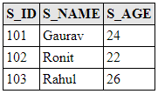
Output
After the execution of the program, the student table is generated under MySQL workbench.This table contains the student details.To fetch data, run select * from student query in MySQL.

Slide 123
Finding an entity
To find an entity, EntityManger interface provides find() method that searches an element on the basis of primary key.
JPA Entity Finding Example
Here, we will search a particular record and fetch it on the console.
This example contains the following steps: -
Create an entity class named as StudentEntity.java under com.javatpoint.jpa.student package that contains attributes s_id, s_name, s_age.

Slide 124
StudentEntity.java
package com.javatpoint.jpa.student;
import javax.persistence.*;
@Entity
@Table(name="student")
public class StudentEntity {
@Id
private int s_id;
private String s_name;
private int s_age;
public StudentEntity(int s_id, String s_name, int s_age) {
super();
this.s_id = s_id;
this.s_name = s_name;
this.s_age = s_age;
}
public StudentEntity() {
super();
}
public int getS_id() {
return s_id;
}
public void setS_id(int s_id) {
this.s_id = s_id;
}
public String getS_name() {
return s_name;
}
public void setS_name(String s_name) {
this.s_name = s_name;
}
public int getS_age() {
return s_age;
}
public void setS_age(int s_age) {
this.s_age = s_age;
}
}

Slide 125
Persistence.xml
Now, map the entity class and other databases confiuguration in Persistence.xml file.
<persistence>
<persistence-unit name="Student_details">
<class>com.javatpoint.jpa.student.StudentEntity</class>
<properties>
<property name="javax.persistence.jdbc.driver" value="com.mysql.jdbc.Driver"/>
<property name="javax.persistence.jdbc.url" value="jdbc:mysql://localhost:3306/studentdata"/>
<property name="javax.persistence.jdbc.user" value="root"/>
<property name="javax.persistence.jdbc.password" value=""/>
<property name="eclipselink.logging.level" value="SEVERE"/>
<property name="eclipselink.ddl-generation" value="create-or-extend-tables"/>
</properties>
</persistence-unit>
</persistence>

Slide 126
FindStudent.java
Create a persistence class named as FindStudent.java under com.javatpoint.jpa.find package to persist the entity object with data.
package com.javatpoint.jpa.find;
import javax.persistence.*;
import com.javatpoint.jpa.student.*;
public class FindStudent {
public static void main(String args[])
{
EntityManagerFactory emf=Persistence.createEntityManagerFactory("Student_details");
EntityManager em=emf.createEntityManager();
StudentEntity s=em.find(StudentEntity.class,101);
System.out.println("Student id = "+s.getS_id());
System.out.println("Student Name = "+s.getS_name());
System.out.println("Student Age = "+s.getS_age());
}
}

Slide 127
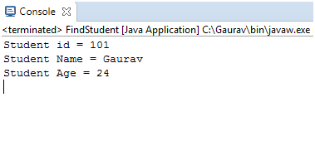
Output

Slide 128
Update an Entity
JPA allows us to change the records in database by updating an entity.
JPA Entity Update Example
Here, we will update the age of a student on the basis of primary key.
This example contains the following steps: -
Create an entity class named as StudentEntity.java under com.javatpoint.jpa.student package that contains attributes s_id, s_name and s_age.

Slide 129
StudentEntity.java
Create an entity class named as StudentEntity.java under com.javatpoint.jpa.student package that contains attributes s_id, s_name and s_age.
package com.javatpoint.jpa.student;
import javax.persistence.*;
@Entity
@Table(name="student")
public class StudentEntity {
@Id
private int s_id;
private String s_name;
private int s_age;
public StudentEntity(int s_id, String s_name, int s_age) {
super();
this.s_id = s_id;
this.s_name = s_name;
this.s_age = s_age;
}
public StudentEntity() {
super();
}
public int getS_id() {
return s_id;
}
public void setS_id(int s_id) {
this.s_id = s_id;
}
public String getS_name() {
return s_name;
}
public void setS_name(String s_name) {
this.s_name = s_name;
}
public int getS_age() {
return s_age;
}
public void setS_age(int s_age) {
this.s_age = s_age;
}
}

Slide 130
Persistence.xml
Now, map the entity class and other databases confiuguration in Persistence.xml file.
<persistence>
<persistence-unit name="Student_details">
<class>com.javatpoint.jpa.student.StudentEntity</class>
<properties>
<property name="javax.persistence.jdbc.driver" value="com.mysql.jdbc.Driver"/>
<property name="javax.persistence.jdbc.url" value="jdbc:mysql://localhost:3306/studentdata"/>
<property name="javax.persistence.jdbc.user" value="root"/>
<property name="javax.persistence.jdbc.password" value=""/>
<property name="eclipselink.logging.level" value="SEVERE"/>
<property name="eclipselink.ddl-generation" value="create-or-extend-tables"/>
</properties>
</persistence-unit>
</persistence>

Slide 131
UpdateStudent.java
Create a persistence class named as UpdateStudent.java under com.javatpoint.jpa.update package to persist the entity object with data.
package com.javatpoint.jpa.update;
import javax.persistence.*;
import com.javatpoint.jpa.student.*;
public class UpdateStudent {
public static void main(String args[])
{
EntityManagerFactory emf=Persistence.createEntityManagerFactory("Student_details");
EntityManager em=emf.createEntityManager();
StudentEntity s=em.find(StudentEntity.class,102);
System.out.println("Before Updation");
System.out.println("Student id = "+s.getS_id());
System.out.println("Student Name = "+s.getS_name());
System.out.println("Student Age = "+s.getS_age());
s.setS_age(30);
System.out.println("After Updation");
System.out.println("Student id = "+s.getS_id());
System.out.println("Student Name = "+s.getS_name());
System.out.println("Student Age = "+s.getS_age());
}
}

Slide 132
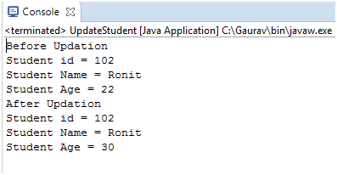
Output

Slide 133
Deleting an Entity
To delete a record from database, EntityManager interface provides remove() method. The remove() method uses primary key to delete the particular record.
JPA Entity Delete Example
Here, we will remove the particular record of the student.
This example contains the following steps: -

Slide 134
StudentEntity.java
Create an entity class named as StudentEntity.java under com.javatpoint.jpa.student package that contains attributes s_id, s_name and s_age.
package com.javatpoint.jpa.student;
import javax.persistence.*;
@Entity
@Table(name="student")
public class StudentEntity {
@Id
private int s_id;
private String s_name;
private int s_age;
public StudentEntity(int s_id, String s_name, int s_age) {
super();
this.s_id = s_id;
this.s_name = s_name;
this.s_age = s_age;
}
public StudentEntity() {
super();
}
public int getS_id() {
return s_id;
}
public void setS_id(int s_id) {
this.s_id = s_id;
}
public String getS_name() {
return s_name;
}
public void setS_name(String s_name) {
this.s_name = s_name;
}
public int getS_age() {
return s_age;
}
public void setS_age(int s_age) {
this.s_age = s_age;
}
}

Slide 135
Persistence.xml
Now, map the entity class and other databases confiuguration in Persistence.xml file.
<persistence>
<persistence-unit name="Student_details">
<class>com.javatpoint.jpa.student.StudentEntity</class>
<properties>
<property name="javax.persistence.jdbc.driver" value="com.mysql.jdbc.Driver"/>
<property name="javax.persistence.jdbc.url" value="jdbc:mysql://localhost:3306/studentdata"/>
<property name="javax.persistence.jdbc.user" value="root"/>
<property name="javax.persistence.jdbc.password" value=""/>
<property name="eclipselink.logging.level" value="SEVERE"/>
<property name="eclipselink.ddl-generation" value="create-or-extend-tables"/>
</properties>
</persistence-unit>
</persistence>

Slide 136
Deletion.java
package com.javatpoint.jpa.delete;
import javax.persistence.*;
import com.javatpoint.jpa.student.*;
public class DeleteStudent {
public static void main(String args[])
{
EntityManagerFactory emf=Persistence.createEntityManagerFactory("Student_details");
EntityManager em=emf.createEntityManager();
em.getTransaction().begin();
StudentEntity s=em.find(StudentEntity.class,102);
em.remove(s);
em.getTransaction().commit();
emf.close();
em.close();
}
}

Slide 137
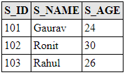

Output
After the execution of the program, the student table is generated under MySQL workbench.This table contains the student details. To fetch data, run select * from student query in MySQL.
Before Deletion
After Deletion

Slide 138
Collection Mapping
A Collection is a java framework that groups multiple objects into a single unit. It is used to store, retrieve and manipulate the aggregate data.
In JPA, we can persist the object of wrapper classes and String using collections. JPA allows three kinds of objects to store in mapping collections - Basic Types, Entities and Embeddables.

Slide 139
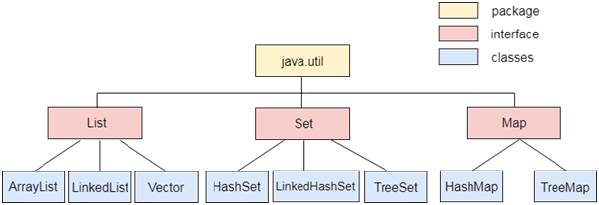
Collection Types
use different type of collections to persist the objects.
List
Set
Map
The java.util package contains all the classes and interfaces of collection framework.

Slide 140
JPA List Mapping
A List is an interface which is used to insert and delete elements on the basis of index. It can be used when there is a requirement of retrieving elements in a user-defined order.
List Mapping Example
In this example, we embed an object in an entity class and define it as a collection type List.
private List<Address> address=new ArrayList<Address>();
This example contains the following steps: -

Slide 141
Employee.java
Create an entity class Employee.java under com.javatpoint.jpa package that contains employee id, name and embedded object (employee Address). The annotation @ElementCollection represents the embedded object.
package com.javatpoint.jpa;
import java.util.*;
import javax.persistence.*;
@Entity
public class Employee {
@Id
@GeneratedValue(strategy=GenerationType.AUTO)
private int e_id;
private String e_name;
@ElementCollection
private List<Address> address=new ArrayList<Address>();
public int getE_id() {
return e_id;
}
public void setE_id(int e_id) {
this.e_id = e_id;
}
public String getE_name() {
return e_name;
}
public void setE_name(String e_name) {
this.e_name = e_name;
}
public List<Address> getAddress() {
return address;
}
public void setAddress(List<Address> address) {
this.address = address;
}
}

Slide 142
Address.java
Now, create a class of embedded object Address.java under com.javatpoint.jpa package. The annotation @Embeddable represents the embeddable object.
package com.javatpoint.jpa;
import javax.persistence.*;
@Embeddable
public class Address {
private int e_pincode;
private String e_city;
private String e_state;
public int getE_pincode() {
return e_pincode;
}
public void setE_pincode(int e_pincode) {
this.e_pincode = e_pincode;
}
public String getE_city() {
return e_city;
}
public void setE_city(String e_city) {
this.e_city = e_city;
}
public String getE_state() {
return e_state;
}
public void setE_state(String e_state) {
this.e_state = e_state;
}
}

Slide 143
Persistence.xml
Now, map the entity class and other databases confiuguration in Persistence.xml file.
<persistence>
<persistence-unit name="Collection_Type">
<class>com.javatpoint.jpa.Employee</class>
<class>com.javatpoint.jpa.Address</class>
<properties>
<property name="javax.persistence.jdbc.driver" value="com.mysql.jdbc.Driver"/>
<property name="javax.persistence.jdbc.url" value="jdbc:mysql://localhost:3306/collection_mapping"/>
<property name="javax.persistence.jdbc.user" value="root"/>
<property name="javax.persistence.jdbc.password" value=""/>
<property name="eclipselink.logging.level" value="SEVERE"/>
<property name="eclipselink.ddl-generation" value="create-or-extend-tables"/>
</properties>
</persistence-unit>
</persistence>

Slide 144
ListMapping.java
Create a persistence class ListMapping.java under com.javatpoint.collection package to persist the entity object with data.
package com.javatpoint.collection;
import javax.persistence.*;
import com.javatpoint.jpa.*;
public class ListMapping{
public static void main(String[] args) {
EntityManagerFactory emf=Persistence.createEntityManagerFactory("Collection_Type");
EntityManager em=emf.createEntityManager();
em.getTransaction().begin();
Address a1=new Address();
a1.setE_pincode(201301);
a1.setE_city("Noida");
a1.setE_state("Uttar Pradesh");
Address a2=new Address();
a2.setE_pincode(302001);
a2.setE_city("Jaipur");
a2.setE_state("Rajasthan");
Employee e1=new Employee();
e1.setE_id(1);
e1.setE_name("Vijay");
e1.getAddress().add(a1);
Employee e2=new Employee();
e2.setE_id(2);
e2.setE_name("John");
e2.getAddress().add(a2);
em.persist(e1);
em.persist(e2);
em.getTransaction().commit();
em.close();
emf.close();
}
}

Slide 145


Output
After the execution of the program, the following table are generated under MySQL workbench.
Employee table - This table contains the employee details. To fetch data, run select * from employee query in MySQL.
Employee_address table - This table represents the mapping between employee and address table. To fetch data, run select * from employee_address query in MySQL.

Slide 146
JPA Set Mapping
A Set is an interface that contains unique elements. These elements don't maintain any order. A Set can be used when there is a requirement of retrieving unique elements in an unordered manner.
Set Mapping Example
In this example, we embed an object in an entity class and define it as a collection type List.
private Set<Address> address=new HashSet<Address>();
This example contains the following steps: -

Slide 147
Employee.java
Create an entity class Employee.java under com.javatpoint.jpa package that contains employee id, name and embedded object (employee Address). The annotation @ElementCollection represents the embedded object.
package com.javatpoint.jpa;
import java.util.*;
import javax.persistence.*;
@Entity
public class Employee {
@Id
@GeneratedValue(strategy=GenerationType.AUTO)
private int e_id;
private String e_name;
@ElementCollection
private Set<Address> address=new HashSet<Address>();
public int getE_id() {
return e_id;
}
public void setE_id(int e_id) {
this.e_id = e_id;
}
public String getE_name() {
return e_name;
}
public void setE_name(String e_name) {
this.e_name = e_name;
}
public Set<Address> getAddress() {
return address;
}
public void setAddress(Set<Address> address) {
this.address = address;
}
}

Slide 148
Address.java
Now, create a class of embedded object Address.java under com.javatpoint.jpa package. The annotation @Embeddable represents the embeddable object.
package com.javatpoint.jpa;
import javax.persistence.*;
@Embeddable
public class Address {
private int e_pincode;
private String e_city;
private String e_state;
public int getE_pincode() {
return e_pincode;
}
public void setE_pincode(int e_pincode) {
this.e_pincode = e_pincode;
}
public String getE_city() {
return e_city;
}
public void setE_city(String e_city) {
this.e_city = e_city;
}
public String getE_state() {
return e_state;
}
public void setE_state(String e_state) {
this.e_state = e_state;
}
}

Slide 149
Persistence.xml
Now, map the entity class and other databases confiuguration in Persistence.xml file.
<persistence>
<persistence-unit name="Collection_Type">
<class>com.javatpoint.jpa.Employee</class>
<class>com.javatpoint.jpa.Address</class>
<properties>
<property name="javax.persistence.jdbc.driver" value="com.mysql.jdbc.Driver"/>
<property name="javax.persistence.jdbc.url" value="jdbc:mysql://localhost:3306/collection_mapping"/>
<property name="javax.persistence.jdbc.user" value="root"/>
<property name="javax.persistence.jdbc.password" value=""/>
<property name="eclipselink.logging.level" value="SEVERE"/>
<property name="eclipselink.ddl-generation" value="create-or-extend-tables"/>
</properties>
</persistence-unit>
</persistence>

Slide 150
SetMapping.java
Create a persistence class ListMapping.java under com.javatpoint.collection package to persist the entity object with data.
package com.javatpoint.collection;
import javax.persistence.*;
import com.javatpoint.jpa.*;
public class SetMapping{
public static void main(String[] args) {
EntityManagerFactory emf=Persistence.createEntityManagerFactory("Collection_Type");
EntityManager em=emf.createEntityManager();
em.getTransaction().begin();
Address a1=new Address();
a1.setE_pincode(201301);
a1.setE_city("Noida");
a1.setE_state("Uttar Pradesh");
Address a2=new Address();
a2.setE_pincode(302001);
a2.setE_city("Jaipur");
a2.setE_state("Rajasthan");
Address a3=new Address();
a3.setE_pincode(133301);
a3.setE_city("Chandigarh");
a3.setE_state("Punjab");
Address a4=new Address();
a4.setE_pincode(80001);
a4.setE_city("Patna");
a4.setE_state("Bihar");
Employee e1=new Employee();
e1.setE_id(1);
e1.setE_name("Vijay");
Employee e2=new Employee();
e2.setE_id(2);
e2.setE_name("Vijay");
Employee e3=new Employee();
e3.setE_id(3);
e3.setE_name("William");
Employee e4=new Employee();
e4.setE_id(4);
e4.setE_name("Rahul");
e1.getAddress().add(a1);
e2.getAddress().add(a2);
e3.getAddress().add(a3);
e4.getAddress().add(a4);
em.persist(e1);
em.persist(e2);
em.persist(e3);
em.persist(e4);
em.getTransaction().commit();
em.close();
emf.close();
}
}

Slide 151
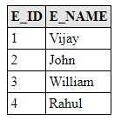
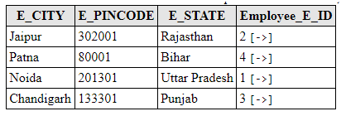
Output
After the execution of the program, the following tables are generated under MySQL workbench.
Employee table - This table contains the employee details. To fetch data, run select * from employee query in MySQL.
Employee_address table - This table represents the mapping between employee and address table. The data in the table is arranged in an unordered manner.To fetch data, run select * from employee_address query in MySQL.

Slide 152
JPA Map Mapping
A Map is an interface in which a unique key is associated with each value object. Thus, operations like search, update, delete are performed on the basis of key.
Map Mapping Example
In this example, we embed an object in an entity class and define it as a collection type Map.
private Map<Integer,Address> map=new HashMap<Integer,Address>();
This example contains the following steps: -

Slide 153
Employee.java
Create an entity class Employee.java under com.javatpoint.jpa package that contains employee id, name and embedded object (employee Address). The annotation @ElementCollection represents the embedded object.
package com.javatpoint.jpa;
import java.util.*;
import javax.persistence.*;
@Entity
public class Employee {
@Id
@GeneratedValue(strategy=GenerationType.AUTO)
private int e_id;
private String e_name;
@ElementCollection
private Map<Integer,Address> map=new HashMap<Integer,Address>();
public int getE_id() {
return e_id;
}
public void setE_id(int e_id) {
this.e_id = e_id;
}
public String getE_name() {
return e_name;
}
public void setE_name(String e_name) {
this.e_name = e_name;
}
public Map<Integer, Address> getMap() {
return map;
}
public void setMap(Map<Integer, Address> map) {
this.map = map;
}
}

Slide 154
Address.java
Now, create a class of embedded object Address.java under com.javatpoint.jpa package. The annotation @Embeddable represents the embeddable object.
package com.javatpoint.jpa;
import javax.persistence.*;
@Embeddable
public class Address {
private int e_pincode;
private String e_city;
private String e_state;
public int getE_pincode() {
return e_pincode;
}
public void setE_pincode(int e_pincode) {
this.e_pincode = e_pincode;
}
public String getE_city() {
return e_city;
}
public void setE_city(String e_city) {
this.e_city = e_city;
}
public String getE_state() {
return e_state;
}
public void setE_state(String e_state) {
this.e_state = e_state;
}
}

Slide 155
Persistence.xml
Now, map the entity class and other databases confiuguration in Persistence.xml file.
<persistence>
<persistence-unit name="Collection_Type">
<class>com.javatpoint.jpa.Employee</class>
<class>com.javatpoint.jpa.Address</class>
<properties>
<property name="javax.persistence.jdbc.driver" value="com.mysql.jdbc.Driver"/>
<property name="javax.persistence.jdbc.url" value="jdbc:mysql://localhost:3306/collection_mapping"/>
<property name="javax.persistence.jdbc.user" value="root"/>
<property name="javax.persistence.jdbc.password" value=""/>
<property name="eclipselink.logging.level" value="SEVERE"/>
<property name="eclipselink.ddl-generation" value="create-or-extend-tables"/>
</properties>
</persistence-unit>
</persistence>

Slide 156
MapMapping.java
Create a persistence class MapMapping.java under com.javatpoint.collection package to persist the entity object with data.
package com.javatpoint.collection;
import javax.persistence.*;
import com.javatpoint.jpa.*;
public class ListMapping{
public static void main(String[] args) {
EntityManagerFactory emf=Persistence.createEntityManagerFactory("Collection_Type");
EntityManager em=emf.createEntityManager();
em.getTransaction().begin();
Address a1=new Address();
a1.setE_pincode(201301);
a1.setE_city("Noida");
a1.setE_state("Uttar Pradesh");
Address a2=new Address();
a2.setE_pincode(302001);
a2.setE_city("Jaipur");
a2.setE_state("Rajasthan");
Address a3=new Address();
a3.setE_pincode(133301);
a3.setE_city("Chandigarh");
a3.setE_state("Punjab");
Address a4=new Address();
a4.setE_pincode(80001);
a4.setE_city("Patna");
a4.setE_state("Bihar");
Employee e1=new Employee();
e1.setE_id(1);
e1.setE_name("Vijay");
Employee e2=new Employee();
e2.setE_id(2);
e2.setE_name("Vijay");
Employee e3=new Employee();
e3.setE_id(3);
e3.setE_name("William");
Employee e4=new Employee();
e4.setE_id(4);
e4.setE_name("Rahul");
e1.getMap().put(1, a1);
e2.getMap().put(2, a2);
e3.getMap().put(3, a3);
e4.getMap().put(4, a4);
em.persist(e1);
em.persist(e2);
em.persist(e3);
em.persist(e4);
em.getTransaction().commit();
em.close();
emf.close();
}
}

Slide 157
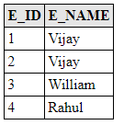
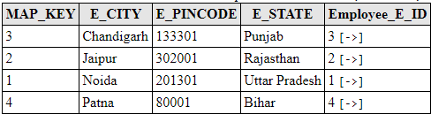
Output
After the execution of the program, the following tables are generated under MySQL workbench.
Employee table - This table contains the employee details. To fetch data, run select * from employee query in MySQL.
Employee_map table - This table represents the mapping between employee and address table. The data in the table is arranged in an unordered manner.To fetch data, run select * from employee_map query in MySQL.

Slide 158
JPA One-To-One Mapping
The One-To-One mapping represents a single-valued association where an instance of one entity is associated with an instance of another entity. In this type of association one instance of source entity can be mapped atmost one instance of target entity.
@OneToOne Example
In this example, we will create a One-To-One relationship between a Student and Library in such a way that one student can be issued only one type of book.
This example contains the following steps: -

Slide 159
Student.java
Create an entity class Student.java under com.javatpoint.mapping package that contains student id (s_id) and student name (s_name).
package com.javatpoint.mapping;
import javax.persistence.*;
@Entity
public class Student {
@Id
@GeneratedValue(strategy=GenerationType.AUTO)
private int s_id;
private String s_name;
public int getS_id() {
return s_id;
}
public void setS_id(int s_id) {
this.s_id = s_id;
}
public String getS_name() {
return s_name;
}
public void setS_name(String s_name) {
this.s_name = s_name;
}
}

Slide 160
Library.java
Create another entity class Library.java under com.javatpoint.mapping package that contains book id (b_id), book name (b_name) and an object of student type marked with @OneToOne annotation.
package com.javatpoint.mapping;
import javax.persistence.*;
@Entity
public class Library {
@Id
@GeneratedValue(strategy=GenerationType.AUTO)
private int b_id;
private String b_name;
@OneToOne
private Student stud;
public Library(int b_id, String b_name, Student stud) {
super();
this.b_id = b_id;
this.b_name = b_name;
this.stud = stud;
}
public Library() {
super();
}
public int getB_id() {
return b_id;
}
public void setB_id(int b_id) {
this.b_id = b_id;
}
public String getB_name() {
return b_name;
}
public void setB_name(String b_name) {
this.b_name = b_name;
}
public Student getStud() {
return stud;
}
public void setStud(Student stud) {
this.stud = stud;
}
}

Slide 161
Persistence.xml
Now, map the entity class and other databases confiuguration in Persistence.xml file.
<persistence>
<persistence-unit name="Book_issued">
<class>com.javatpoint.mapping.Student</class>
<class>com.javatpoint.mapping.Library</class>
<properties>
<property name="javax.persistence.jdbc.driver" value="com.mysql.jdbc.Driver"/>
<property name="javax.persistence.jdbc.url" value="jdbc:mysql://localhost:3306/mapping_db"/>
<property name="javax.persistence.jdbc.user" value="root"/>
<property name="javax.persistence.jdbc.password" value=""/>
<property name="eclipselink.logging.level" value="SEVERE"/>
<property name="eclipselink.ddl-generation" value="create-or-extend-tables"/>
</properties>
</persistence-unit>
</persistence>

Slide 162
OneToOneExample.java
Create a persistence class OneToOneExample under com.javatpoint.OneToOne package to persist the entity object with data.
import javax.persistence.*;
import com.javatpoint.mapping.*;
public class OneToOneExample {
public static void main(String[] args) {
EntityManagerFactory emf = Persistence.createEntityManagerFactory( "Book_issued" );
EntityManager em = emf.createEntityManager( );
em.getTransaction( ).begin( );
Student st1=new Student();
st1.setS_id(1);
st1.setS_name("Vipul");
Student st2=new Student();
st2.setS_id(2);
st2.setS_name("Vimal");
em.persist(st1);
em.persist(st2);
Library lib1=new Library();
lib1.setB_id(101);
lib1.setB_name("Data Structure");
lib1.setStud(st1);
Library lib2=new Library();
lib2.setB_id(102);
lib2.setB_name("DBMS");
lib2.setStud(st2);
em.persist(lib1);
em.persist(lib2);
em.getTransaction().commit();
em.close();
emf.close();
}
}

Slide 163


Output
After the execution of the program, two tables are generated under MySQL workbench.
Student table - This table contains the student details. To fetch data, run select * from student query in MySQL.
Library table - This table represents the mapping between student and library. To fetch data, run select * from library query in MySQL.

Slide 164
JPA One-To-Many Mapping
The One-To-Many mapping comes into the category of collection-valued association where an entity is associated with a collection of other entities. Hence, in this type of association the instance of one entity can be mapped with any number of instances of another entity.
@OneToMany Example
In this example, we will create a One-To-Many relationship between a Student and Library in such a way that one student can be issued more than one type of book.
This example contains the following steps: -

Slide 165
Student.java
Create an entity class Student.java under com.javatpoint.mapping package that contains student id (s_id), student name (s_name) with @OneToMany annotation that contains Library class object of List type.
package com.javatpoint.mapping;
import java.util.List;
import javax.persistence.*;
@Entity
public class Student {
@Id
@GeneratedValue(strategy=GenerationType.AUTO)
private int s_id;
private String s_name;
@OneToMany(targetEntity=Library.class)
private List books_issued;
public List getBooks_issued() {
return books_issued;
}
public void setBooks_issued(List books_issued) {
this.books_issued = books_issued;
}
public int getS_id() {
return s_id;
}
public void setS_id(int s_id) {
this.s_id = s_id;
}
public String getS_name() {
return s_name;
}
public void setS_name(String s_name) {
this.s_name = s_name;
}
}

Slide 166
Library.java
Create another entity class Library.java under com.javatpoint.mapping package that contains book id (b_id), book name (b_name).
package com.javatpoint.mapping;
import javax.persistence.*;
@Entity
public class Library {
@Id
@GeneratedValue(strategy=GenerationType.AUTO)
private int b_id;
private String b_name;
public Library(int b_id, String b_name) {
super();
this.b_id = b_id;
this.b_name = b_name;
}
public Library() {
super();
// TODO Auto-generated constructor stub
}
public int getB_id() {
return b_id;
}
public void setB_id(int b_id) {
this.b_id = b_id;
}
public String getB_name() {
return b_name;
}
public void setB_name(String b_name) {
this.b_name = b_name;
}
}

Slide 167
Persistence.xml
Now, map the entity class and other databases confiuguration in Persistence.xml file.
<persistence>
<persistence-unit name="books_issued">
<class>com.javatpoint.mapping.Student</class>
<class>com.javatpoint.mapping.Library</class>
<properties>
<property name="javax.persistence.jdbc.driver" value="com.mysql.jdbc.Driver"/>
<property name="javax.persistence.jdbc.url" value="jdbc:mysql://localhost:3306/mapping_db"/>
<property name="javax.persistence.jdbc.user" value="root"/>
<property name="javax.persistence.jdbc.password" value=""/>
<property name="eclipselink.logging.level" value="SEVERE"/>
<property name="eclipselink.ddl-generation" value="create-or-extend-tables"/>
</properties>
</persistence-unit>
</persistence>

Slide 168
OneToManyExample.java
Create a persistence class OneToManyExample under com.javatpoint.OneToOne package to persist the entity object with data.
package com.javatpoint.OneToMany;
import java.util.ArrayList;
import javax.persistence.*;
import com.javatpoint.mapping.Student;
import com.javatpoint.mapping.Library;
public class OneToManyExample {
public static void main(String[] args) {
EntityManagerFactory emf=Persistence.createEntityManagerFactory("books_issued");
EntityManager em=emf.createEntityManager();
em.getTransaction().begin();
Library lib1=new Library();
lib1.setB_id(101);
lib1.setB_name("Data Structure");
Library lib2=new Library();
lib2.setB_id(102);
lib2.setB_name("DBMS");
em.persist(lib1);
em.persist(lib2);
ArrayList<Library> list=new ArrayList<Library>();
list.add(lib1);
list.add(lib2);
Student st1=new Student();
st1.setS_id(1);
st1.setS_name("Vipul");
st1.setBooks_issued(list);
em.persist(st1);
em.getTransaction().commit();
em.close();
emf.close();
}
}

Slide 169



Output
After the execution of the program, three tables are generated under MySQL workbench.
Student table - This table contains the student details. To fetch data, run select * from student query in MySQL.
Library Table - This table contains the library book details. To fetch data, run select * from library query in MySQL.
Student_library table - This table represents the mapping between student and library table. To fetch data, run select * from student_library query in MySQL.

Slide 170
JPA Many-To-One Mapping
The Many-To-One mapping represents a single-valued association where a collection of entities can be associated with the similar entity. Hence, in relational database any more than one row of an entity can refer to the similar rows of another entity.
@ManyToOne Example
In this example, we will create a Many-To-One relationship between a Student and Library in such a way that more than one student can issued the same book.
This example contains the following steps: -

Slide 171
Student.java
Create an entity class Student.java under com.javatpoint.mapping package that contains student id (s_id) and student name (s_name) with @ManyToOne annotation that contains an object of Library type.
package com.javatpoint.mapping;
import javax.persistence.*;
@Entity
public class Student {
@Id
@GeneratedValue(strategy=GenerationType.AUTO)
private int s_id;
private String s_name;
@ManyToOne
private Library lib;
public int getS_id() {
return s_id;
}
public void setS_id(int s_id) {
this.s_id = s_id;
}
public String getS_name() {
return s_name;
}
public void setS_name(String s_name) {
this.s_name = s_name;
}
public Library getLib() {
return lib;
}
public void setLib(Library lib) {
this.lib = lib;
}
}

Slide 172
Library.java
Create another entity class Library.java under com.javatpoint.mapping package that contains book id (b_id), book name (b_name).
package com.javatpoint.mapping;
import javax.persistence.*;
@Entity
public class Library {
@Id
@GeneratedValue(strategy=GenerationType.AUTO)
private int b_id;
private String b_name;
public Library(int b_id, String b_name) {
super();
this.b_id = b_id;
this.b_name = b_name;
}
public Library() {
super();
// TODO Auto-generated constructor stub
}
public int getB_id() {
return b_id;
}
public void setB_id(int b_id) {
this.b_id = b_id;
}
public String getB_name() {
return b_name;
}
public void setB_name(String b_name) {
this.b_name = b_name;
}
}

Slide 173
Persistence.xml
Now, map the entity class and other databases confiuguration in Persistence.xml file.
<persistence>
<persistence-unit name="books_issued">
<class>com.javatpoint.mapping.Student</class>
<class>com.javatpoint.mapping.Library</class>
<properties>
<property name="javax.persistence.jdbc.driver" value="com.mysql.jdbc.Driver"/>
<property name="javax.persistence.jdbc.url" value="jdbc:mysql://localhost:3306/mapping_db"/>
<property name="javax.persistence.jdbc.user" value="root"/>
<property name="javax.persistence.jdbc.password" value=""/>
<property name="eclipselink.logging.level" value="SEVERE"/>
<property name="eclipselink.ddl-generation" value="create-or-extend-tables"/>
</properties>
</persistence-unit>
</persistence>

Slide 174
ManyToOneExample.java
Create a persistence class ManyToOneExample under com.javatpoint.ManyToOne package to persist the entity object with data.
package com.javatpoint.mapping.ManyToOne;
import javax.persistence.*;
import com.javatpoint.mapping.Student;
import javax.persistence.EntityManagerFactory;
import com.javatpoint.mapping.Library;
public class ManyToOneExample {
public static void main(String[] args) {
EntityManagerFactory emf=Persistence.createEntityManagerFactory("books_issued");
EntityManager em=emf.createEntityManager();
em.getTransaction().begin();
Library lib=new Library();
lib.setB_id(101);
lib.setB_name("Data Structure");
em.persist(lib);
Student st1=new Student();
st1.setS_id(1);
st1.setS_name("Vipul");
st1.setLib(lib);
Student st2=new Student();
st2.setS_id(2);
st2.setS_name("Vimal");
st2.setLib(lib);
em.persist(st1);;
em.persist(st2);
em.getTransaction().commit();
em.close();
emf.close();
}
}

Slide 175


Output
After the execution of the program, the two tables generates under MySQL workbench.
Library table - This table contains the library details. To fetch data, run select * from library query in MySQL.
Student table - This table represents the mapping between student and library. To fetch data, run select * from student query in MySQL.

Slide 176
JPA Many-To-Many Mapping
The Many-To-Many mapping represents a collection-valued association where any number of entities can be associated with a collection of other entities. In relational database any number of rows of one entity can be referred to any number of rows of another entity.
@ManyToMany Example
In this example, we will create a Many-To-Many relationship between a Student and Library in such a way that any number of students can be issued any type of books.
This example contains the following steps: -

Slide 177
Student.java
Create an entity class Student.java under com.javatpoint.mapping package that contains student id (s_id) and student name (s_name) with @ManyToMany annotation that contains Library class object of List type.
import java.util.List;
import javax.persistence.*;
@Entity
public class Student {
@Id
@GeneratedValue(strategy=GenerationType.AUTO)
private int s_id;
private String s_name;
@ManyToMany(targetEntity=Library.class)
private List lib;
public Student(int s_id, String s_name, List lib) {
super();
this.s_id = s_id;
this.s_name = s_name;
this.lib = lib;
}
public Student() {
super();
// TODO Auto-generated constructor stub
}
public List getLib() {
return lib;
}
public void ListLib(List lib) {
this.lib = lib;
}
public int getS_id() {
return s_id;
}
public void ListS_id(int s_id) {
this.s_id = s_id;
}
public String getS_name() {
return s_name;
}
public void ListS_name(String s_name) {
this.s_name = s_name;
}
}

Slide 178
Library.java
Create another entity class Library.java under com.javatpoint.mapping package that contains book id (b_id), book name (b_name) with @ManyToMany annotation that contains Student class object of List type.
package com.javatpoint.mapping;
import java.util.List;
import javax.persistence.*;
@Entity
public class Library {
@Id
@GeneratedValue(strategy=GenerationType.AUTO)
private int b_id;
private String b_name;
@ManyToMany(targetEntity=Student.class)
private List stud;
public Library(int b_id, String b_name, List stud) {
super();
this.b_id = b_id;
this.b_name = b_name;
this.stud = stud;
}
public Library() {
super();
// TODO Auto-generated constructor stub
}
public int getB_id() {
return b_id;
}
public void ListB_id(int b_id) {
this.b_id = b_id;
}
public String getB_name() {
return b_name;
}
public void ListB_name(String b_name) {
this.b_name = b_name;
}
public List getStud() {
return stud;
}
public void ListStud(List stud) {
this.stud = stud;
}
}

Slide 179
Persistence.xml
Now, map the entity class and other databases confiuguration in Persistence.xml file.
<persistence>
<persistence-unit name="books_issued">
<class>com.javatpoint.mapping.Student</class>
<class>com.javatpoint.mapping.Library</class>
<properties>
<property name="javax.persistence.jdbc.driver" value="com.mysql.jdbc.Driver"/>
<property name="javax.persistence.jdbc.url" value="jdbc:mysql://localhost:3306/mapping_db"/>
<property name="javax.persistence.jdbc.user" value="root"/>
<property name="javax.persistence.jdbc.password" value=""/>
<property name="eclipselink.logging.level" value="SEVERE"/>
<property name="eclipselink.ddl-generation" value="create-or-extend-tables"/>
</properties>
</persistence-unit>
</persistence>

Slide 180
ManyToManyExample.java
Create a persistence class ManyToOneExample under com.javatpoint.ManyToOne package to persist the entity object with data.
package com.javatpoint.mapping.ManyToMany;
import java.util.ArrayList;
import javax.persistence.*;
import com.javatpoint.mapping.Student;
import com.javatpoint.mapping.Library;
public class ManyToManyExample {
public static void main(String[] args) {
EntityManagerFactory emf=Persistence.createEntityManagerFactory("books_issued");
EntityManager em=emf.createEntityManager();
em.getTransaction().begin();
Student st1=new Student(1,"Vipul",null);
Student st2=new Student(2,"Vimal",null);
em.persist(st1);
em.persist(st2);
ArrayList<Student> al1=new ArrayList<Student>();
ArrayList<Student> al2=new ArrayList<Student>();
al1.add(st1);
al1.add(st2);
al2.add(st1);
al2.add(st2);
Library lib1=new Library(101,"Data Structure",al1);
Library lib2=new Library(102,"DBMS",al2);
em.persist(lib1);
em.persist(lib2);
em.getTransaction().commit();
em.close();
emf.close();
}
}

Slide 181


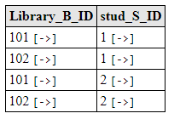
Output
After the execution of the program, three tables are generated under MySQL workbench.
Student table - This table contains the student details. To fetch data, run select * from student query in MySQL.
Library table - This table contains the library details. To fetch data, run select * from library query in MySQL.
Library_student - This table contains the library details. To fetch data, run select * from library_student query in MySQL.

Slide 182
JPQL(Java Persistence Query Language
an object-oriented query language which is used to perform database operations on persistent entities.
Instead of database table, JPQL uses entity object model to operate the SQL queries. Here, the role of JPA is to transform JPQL into SQL. Thus, it provides an easy platform for developers to handle SQL tasks.
JPQL is an extension of Entity JavaBeans Query Language (EJBQL)
It can perform join operations.
It can update and delete data in a bulk.
It can perform aggregate function with sorting and grouping clauses.
Single and multiple value result types.

Slide 183
JPQL Features
It is a platform-independent query language.
It is simple and robust.
It can be used with any type of database such as MySQL, Oracle.
JPQL queries can be declared statically into metadata or can also be dynamically built in code.

Slide 184
Creating Queries in JPQL
JPQL provides two methods that can be used to access database records. These methods are: -
Query createQuery(String name) - The createQuery() method of EntityManager interface is used to create an instance of Query interface for executing JPQL statement.
Query query = em.createQuery("Select s.s_name from StudentEntity s");
This method creates dynamic queries that can be defined within business logic.
Query createNamedQuery(String name) - The createNamedQuery() method of EntityManager interface is used to create an instance of Query interface for executing named queries.
@NamedQuery(name = "find name" , query = "Select s from StudentEntity s")
This method is used to create static queries that can be defined in entity class.
Now, we can control the execution of query by the following Query interface methods: -
int executeUpdate() - This method executes the update and delete operation.
int getFirstResult() - This method returns the first positioned result the query object was set to retrieve.
int getMaxResults() - This method returns the maximum number of results the query object was set to retrieve.
java.util.List getResultList() - This method returns the list of results as an untyped list.
Query setFirstResult(int startPosition) - This method assigns the position of first result to retrieve.
Query setMaxResults(int maxResult) - This method assigns the maximum numbers of result to retrieve.

Slide 185
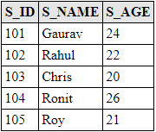
JPA JPQL Basic Operations
JPQL allows us to create both static as well as dynamic queries. Now, we will perform some basic JPQL operations using both type of queries on the below table.

Slide 186
JPQL Dynamic Query Example
In this example, we will fetch single column from database by using createQuery() method .
StudentEntity.java
package com.javatpoint.jpa;
import javax.persistence.*;
@Entity
@Table(name="student")
public class StudentEntity {
@Id
private int s_id;
private String s_name;
private int s_age;
public StudentEntity(int s_id, String s_name, int s_age) {
super();
this.s_id = s_id;
this.s_name = s_name;
this.s_age = s_age;
}
public StudentEntity() {
super();
}
public int getS_id() {
return s_id;
}
public void setS_id(int s_id) {
this.s_id = s_id;
}
public String getS_name() {
return s_name;
}
public void setS_name(String s_name) {
this.s_name = s_name;
}
public int getS_age() {
return s_age;
}
public void setS_age(int s_age) {
this.s_age = s_age;
}
}

Slide 187
Persistence.xml
<persistence>
<persistence-unit name="Student_details">
<class>com.javatpoint.jpa.StudentEntity</class>
<properties>
<property name="javax.persistence.jdbc.driver" value="com.mysql.jdbc.Driver"/>
<property name="javax.persistence.jdbc.url" value="jdbc:mysql://localhost:3306/studentdata"/>
<property name="javax.persistence.jdbc.user" value="root"/>
<property name="javax.persistence.jdbc.password" value=""/>
<property name="eclipselink.logging.level" value="SEVERE"/>
<property name="eclipselink.ddl-generation" value="create-or-extend-tables"/>
</properties>
</persistence-unit>
</persistence>

Slide 188
FetchColumn.java
package com.javatpoint.jpa.jpql;
import javax.persistence.*;
import java.util.*;
public class FetchColumn {
public static void main( String args[]) {
EntityManagerFactory emf = Persistence.createEntityManagerFactory( "Student_details" );
EntityManager em = emf.createEntityManager();
em.getTransaction().begin( );
Query query = em.createQuery("Select s.s_name from StudentEntity s");
@SuppressWarnings("unchecked")
List<String> list =query.getResultList();
System.out.println("Student Name :");
for(String s:list) {
System.out.println(s);
}
em.close();
emf.close();
}
}

Slide 189
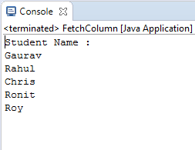
Output

Slide 190
JPQL Static Query Example
In this example, we will fetch single column from database by using createNamedQuery() method .
StudentEntity.java
package com.javatpoint.jpa;
import javax.persistence.*;
@Entity
@Table(name="student")
@NamedQuery(name = "find name" , query = "Select s from StudentEntity s")
public class StudentEntity {
@Id
private int s_id;
private String s_name;
private int s_age;
public StudentEntity(int s_id, String s_name, int s_age) {
super();
this.s_id = s_id;
this.s_name = s_name;
this.s_age = s_age;
}
public StudentEntity() {
super();
}
public int getS_id() {
return s_id;
}
public void setS_id(int s_id) {
this.s_id = s_id;
}
public String getS_name() {
return s_name;
}
public void setS_name(String s_name) {
this.s_name = s_name;
}
public int getS_age() {
return s_age;
}
public void setS_age(int s_age) {
this.s_age = s_age;
}
}

Slide 191
Persistence.xml
<persistence>
<persistence-unit name="Student_details">
<class>com.javatpoint.jpa.StudentEntity</class>
<properties>
<property name="javax.persistence.jdbc.driver" value="com.mysql.jdbc.Driver"/>
<property name="javax.persistence.jdbc.url" value="jdbc:mysql://localhost:3306/studentdata"/>
<property name="javax.persistence.jdbc.user" value="root"/>
<property name="javax.persistence.jdbc.password" value=""/>
<property name="eclipselink.logging.level" value="SEVERE"/>
<property name="eclipselink.ddl-generation" value="create-or-extend-tables"/>
</properties>
</persistence-unit>
</persistence>

Slide 192
FetchColumn.java
package com.javatpoint.jpa.jpql;
import javax.persistence.*;
import com.javatpoint.jpa.StudentEntity;
import java.util.*;
public class FetchColumn {
public static void main( String args[]) {
EntityManagerFactory emf = Persistence.createEntityManagerFactory( "Student_details" );
EntityManager em = emf.createEntityManager();
em.getTransaction().begin( );
Query query = em.createNamedQuery("find name");
@SuppressWarnings("unchecked")
List<StudentEntity> list =query.getResultList();
System.out.println("Student Name :");
for(StudentEntity s:list) {
System.out.println(s.getS_name());
}
em.close();
emf.close();
}
}

Slide 193
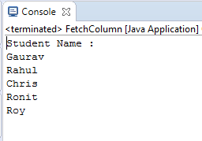
Output

Slide 194
JPA JPQL Bulk Data Operations
to handle bulk data and perform corresponding operations.
JPQL Bulk Data Example
In this example, we will take a basic entity class (in this case StudentEntity.java) and perform different operations on it.

Slide 195
StudentEntity.java
Create an entity class named as StudentEntity.java under com.javatpoint.jpa package.
package com.javatpoint.jpa;
import javax.persistence.*;
@Entity
@Table(name="student")
public class StudentEntity {
@Id
private int s_id;
private String s_name;
private int s_age;
public StudentEntity(int s_id, String s_name, int s_age) {
super();
this.s_id = s_id;
this.s_name = s_name;
this.s_age = s_age;
}
public StudentEntity() {
super();
}
public int getS_id() {
return s_id;
}
public void setS_id(int s_id) {
this.s_id = s_id;
}
public String getS_name() {
return s_name;
}
public void setS_name(String s_name) {
this.s_name = s_name;
}
public int getS_age() {
return s_age;
}
public void setS_age(int s_age) {
this.s_age = s_age;
}
}

Slide 196
Persistence.xml
Now, map the entity class and other databases confiuguration in Persistence.xml file.
<persistence>
<persistence-unit name="Student_details">
<class>com.javatpoint.jpa.StudentEntity</class>
<properties>
<property name="javax.persistence.jdbc.driver" value="com.mysql.jdbc.Driver"/>
<property name="javax.persistence.jdbc.url" value="jdbc:mysql://localhost:3306/studentdata"/>
<property name="javax.persistence.jdbc.user" value="root"/>
<property name="javax.persistence.jdbc.password" value=""/>
<property name="eclipselink.logging.level" value="SEVERE"/>
<property name="eclipselink.ddl-generation" value="create-or-extend-tables"/>
</properties>
</persistence-unit>
</persistence>

Slide 197
JPQL Fetch/FetchData.java
fetch all the records from the database.
package com.javatpoint.jpa.jpql;
import com.javatpoint.jpa.StudentEntity;
import javax.persistence.*;
import java.util.*;
public class FetchData {
public static void main( String args[]) {
EntityManagerFactory emf = Persistence.createEntityManagerFactory( "Student_details" );
EntityManager em = emf.createEntityManager();
em.getTransaction().begin( );
Query query = em.createQuery( "Select s from StudentEntity s ");
@SuppressWarnings("unchecked")
List<StudentEntity> list=(List<StudentEntity>)query.getResultList( );
System.out.print("s_id");
System.out.print("\t s_name");
System.out.println("\t s_age");
for( StudentEntity s:list ){
System.out.print( s.getS_id( ));
System.out.print("\t" + s.getS_name( ));
System.out.print("\t" + s.getS_age( ));
System.out.println();
}
em.getTransaction().commit();
em.close();
emf.close();
}
}

Slide 198
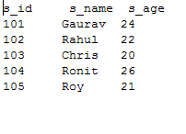
Output

Slide 199
JPQL Update UpdateData.java
update the records in database.
package com.javatpoint.jpa.jpql;
import javax.persistence.*;
public class UpdataData {
public static void main( String args[]) {
EntityManagerFactory emf = Persistence.createEntityManagerFactory( "Student_details" );
EntityManager em = emf.createEntityManager();
em.getTransaction().begin( );
Query query = em.createQuery( "update StudentEntity SET s_age=25 where s_id>103");
query.executeUpdate();
em.getTransaction().commit();
em.close();
emf.close();
}
}

Slide 200
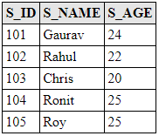
Output
After the execution of the program, the following student table generates under MySQL workbench. To fetch data, run select * from student in MySQL.

Slide 201
JPQL Delete DeleteData.java
delete the particular records from database.
package com.javatpoint.jpa.jpql;
import javax.persistence.*;
public class DeleteData {
public static void main( String args[]) {
EntityManagerFactory emf = Persistence.createEntityManagerFactory( "Student_details" );
EntityManager em = emf.createEntityManager();
em.getTransaction().begin( );
Query query = em.createQuery( "delete from StudentEntity where s_id=102");
query.executeUpdate();
em.getTransaction().commit();
em.close();
emf.close();
}
}

Slide 202
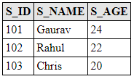
Output
After the execution of the program, the following student table generates under MySQL workbench. To fetch data, run select * from student in MySQL.

Slide 203
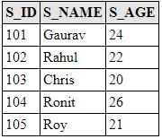
JPA JPQL Advanced Operations
Using JPQL, we can perform any type of database operations. Here, we will perform some advanced operations of JPQL using simple examples.
Let us consider the student table having the following records.

Slide 204
JPQL Advanced Query Examples
In this example, we will take a basic entity class (in this case StudentEntity.java) and perform different operations on it.
Create an entity class named as StudentEntity.java under com.javatpoint.jpa package.
StudentEntity.java
package com.javatpoint.jpa;
import javax.persistence.*;
@Entity
@Table(name="student")
public class StudentEntity {
@Id
private int s_id;
private String s_name;
private int s_age;
public StudentEntity(int s_id, String s_name, int s_age) {
super();
this.s_id = s_id;
this.s_name = s_name;
this.s_age = s_age;
}
public StudentEntity() {
super();
}
public int getS_id() {
return s_id;
}
public void setS_id(int s_id) {
this.s_id = s_id;
}
public String getS_name() {
return s_name;
}
public void setS_name(String s_name) {
this.s_name = s_name;
}
public int getS_age() {
return s_age;
}
public void setS_age(int s_age) {
this.s_age = s_age;
}
}

Slide 205
Persistence.xml
Now, map the entity class and other databases confiuguration in Persistence.xml file.
<persistence>
<persistence-unit name="Student_details">
<class>com.javatpoint.jpa.StudentEntity</class>
<properties>
<property name="javax.persistence.jdbc.driver" value="com.mysql.jdbc.Driver"/>
<property name="javax.persistence.jdbc.url" value="jdbc:mysql://localhost:3306/studentdata"/>
<property name="javax.persistence.jdbc.user" value="root"/>
<property name="javax.persistence.jdbc.password" value=""/>
<property name="eclipselink.logging.level" value="SEVERE"/>
<property name="eclipselink.ddl-generation" value="create-or-extend-tables"/>
</properties>
</persistence-unit>
</persistence>

Slide 206
JPQL Filter
Here, we will perform some filter operations on a table.
Filter.java
package com.javatpoint.jpa.jpql;
import com.javatpoint.jpa.StudentEntity;
import javax.persistence.*;
import java.util.*;
public class Filter {
public static void main( String args[]) {
EntityManagerFactory emf = Persistence.createEntityManagerFactory( "Student_details" );
EntityManager em = emf.createEntityManager();
em.getTransaction().begin( );
Query q1 = em.createQuery("Select s from StudentEntity s where s.s_age between 22 and 28");
@SuppressWarnings("unchecked")
List<StudentEntity> l1 = (List<StudentEntity>)q1.getResultList();
System.out.println("Between Clause");
System.out.print("s_id");
System.out.print("\t s_name");
System.out.println("\t s_age");
for(StudentEntity s:l1)
{
System.out.print(s.getS_id());
System.out.print("\t"+s.getS_name());
System.out.println("\t"+s.getS_age());
}
Query q2 = em.createQuery("Select s from StudentEntity s where s.s_age IN(20,22,23)");
@SuppressWarnings("unchecked")
List<StudentEntity> l2 = (List<StudentEntity>)q2.getResultList();
System.out.println("IN Clause");
System.out.print("s_id");
System.out.print("\t s_name");
System.out.println("\t s_age");
for(StudentEntity s:l2)
{
System.out.print(s.getS_id());
System.out.print("\t"+s.getS_name());
System.out.println("\t"+s.getS_age());
}
Query q3 = em.createQuery("Select s from StudentEntity s where s.s_name like '%a%'");
@SuppressWarnings("unchecked")
List<StudentEntity> l3 = (List<StudentEntity>)q3.getResultList();
System.out.println("Like Clause");
System.out.print("s_id");
System.out.print("\t s_name");
System.out.println("\t s_age");
for(StudentEntity s:l3)
{
System.out.print(s.getS_id());
System.out.print("\t"+s.getS_name());
System.out.println("\t"+s.getS_age());
}
em.getTransaction().commit();
em.close();
emf.close();
}
}

Slide 207
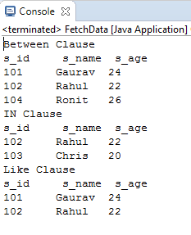
Output

Slide 208
JPQL Aggregate
Here, we will perform some aggregate operations on a table.
Aggregate.java
package com.javatpoint.jpa.jpql;
import com.javatpoint.jpa.StudentEntity;
import javax.persistence.*;
import java.util.*;
public class Aggregate {
public static void main( String args[]) {
EntityManagerFactory emf = Persistence.createEntityManagerFactory( "Student_details" );
EntityManager em = emf.createEntityManager();
em.getTransaction().begin( );
Query q1 = em.createQuery("Select count(s) from StudentEntity s");
System.out.println("Number of Student : "+q1.getSingleResult());
Query q2 = em.createQuery("Select MAX(s.s_age) from StudentEntity s");
System.out.println("Maximum age : "+q2.getSingleResult());
Query q3 = em.createQuery("Select MIN(s.s_age) from StudentEntity s");
System.out.println("Minimum age : "+q3.getSingleResult());
em.getTransaction().commit();
em.close();
emf.close();
}
}

Slide 209

Output

Slide 210
JPQL Sorting
Here, we will sort the elements of table on the basis of s_age attribute.
Sorting.java
package com.javatpoint.jpa.jpql;
import com.javatpoint.jpa.StudentEntity;
import javax.persistence.*;
import java.util.*;
public class Sorting {
public static void main( String args[]) {
EntityManagerFactory emf = Persistence.createEntityManagerFactory( "Student_details" );
EntityManager em = emf.createEntityManager();
em.getTransaction().begin( );
Query q1 = em.createQuery("Select s from StudentEntity s order by s.s_age desc");
@SuppressWarnings("unchecked")
List<StudentEntity> l1 = (List<StudentEntity>)q1.getResultList();
System.out.print("s_id");
System.out.print("\t s_name");
System.out.println("\t s_age");
for(StudentEntity s:l1)
{
System.out.print(s.getS_id());
System.out.print("\t"+s.getS_name());
System.out.println("\t"+s.getS_age());
}
em.getTransaction().commit();
em.close();
emf.close();
}
}

Slide 211
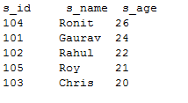
Output

Slide 212
JPA Criteria API
The Criteria API is one of the most common ways of constructing queries for entities and their persistent state. It is just an alternative method for defining JPA queries.
Criteria API defines a platform-independent criteria queries, written in Java programming language. It was introduced in JPA 2.0. The main purpose behind this is to provide a type-safe way to express a query.

Slide 213
Steps to create Criteria Query
To create a Criteria query, follow the below steps: -
Create an object of CriteriaBuilder interface by invoking getCriteriaBuilder() method on the instance of EntityManager interface.
EntityManager em = emf.createEntityManager();
CriteriaBuilder cb=em.getCriteriaBuilder();
Now, build an instance of CriteriaQuery interface to create a query object.
CriteriaQuery<StudentEntity> cq=cb.createQuery(StudentEntity.class);
Call from method on CriteriaQuery object to set the query root.
Root<StudentEntity> stud=cq.from(StudentEntity.class);
Now, call the select method of CriteriaQuery Object to specify type of query result.
CriteriaQuery<StudentEntity> select = cq.select(stud);
Create an instance of Query interface and specify the type of method used to access the database records
Query q = em.createQuery(select);
Now, control the execution of query by calling the methods of Query Interface.
List<StudentEntity> list = q.getResultList();

Slide 214
Methods of Criteria API Query Clauses
Following is the list of clauses with the corresponding interface and methods.
Clause | Criteria API Interface | Methods
SELECT | CriteriaQuery | select()
FROM | AbstractQuery | from()
WHERE | AbstractQuery | where()
ORDER BY | CriteriaQuery | orderBy()
GROUP BY | AbstractQuery | groupBy()
HAVING | AbstractQuery | having()

Slide 215
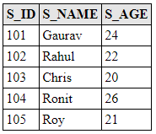
JPA Criteria SELECT Clause
The SELECT clause is used to fetch the data from database. The data can be retrieved in the form of single expression or multiple expressions. In Criteria API, each form is expressed differently.
Criteria SELECT Example
Generally, select() method is used for the SELECT clause to fetch all type of forms. Here, we will perform several SELECT operations on student table. Let us assume the table contains the following records: -

Slide 216
StudentEntity.java
Create an entity class. Here, we created StudentEntity.java under com.javatpoint.jpa package. This class contains three attributes s_id, s_name, s_age with all the required annotations.
package com.javatpoint.jpa;
import javax.persistence.*;
@Entity
@Table(name="student")
public class StudentEntity {
@Id
private int s_id;
private String s_name;
private int s_age;
public StudentEntity(int s_id, String s_name, int s_age) {
super();
this.s_id = s_id;
this.s_name = s_name;
this.s_age = s_age;
}
public StudentEntity() {
super();
}
public int getS_id() {
return s_id;
}
public void setS_id(int s_id) {
this.s_id = s_id;
}
public String getS_name() {
return s_name;
}
public void setS_name(String s_name) {
this.s_name = s_name;
}
public int getS_age() {
return s_age;
}
public void setS_age(int s_age) {
this.s_age = s_age;
}
}

Slide 217
Persistence.xml
Now, map the entity class and other databases confiuguration in Persistence.xml file.
<persistence>
<persistence-unit name="Student_details">
<class>com.javatpoint.jpa.StudentEntity</class>
<properties>
<property name="javax.persistence.jdbc.driver" value="com.mysql.jdbc.Driver"/>
<property name="javax.persistence.jdbc.url" value="jdbc:mysql://localhost:3306/studentdata"/>
<property name="javax.persistence.jdbc.user" value="root"/>
<property name="javax.persistence.jdbc.password" value=""/>
<property name="eclipselink.logging.level" value="SEVERE"/>
<property name="eclipselink.ddl-generation" value="create-or-extend-tables"/>
</properties>
</persistence-unit>
</persistence>

Slide 218
Selecting Single Expression
Here, we will fetch single column from database with the help of a simple example.
SingleFetch.java
package com.javatpoint.jpa.jpql;
import com.javatpoint.jpa.StudentEntity;
import javax.persistence.*;
import javax.persistence.criteria.*;
import java.util.*;
public class SingleFetch {
public static void main( String args[]) {
EntityManagerFactory emf = Persistence.createEntityManagerFactory( "Student_details" );
EntityManager em = emf.createEntityManager();
em.getTransaction().begin( );
CriteriaBuilder cb=em.getCriteriaBuilder();
CriteriaQuery<StudentEntity> cq=cb.createQuery(StudentEntity.class);
Root<StudentEntity> stud=cq.from(StudentEntity.class);
cq.select(stud.get("s_name"));
CriteriaQuery<StudentEntity> select = cq.select(stud);
TypedQuery<StudentEntity> q = em.createQuery(select);
List<StudentEntity> list = q.getResultList();
System.out.println("s_id");
for(StudentEntity s:list)
{
System.out.println(s.getS_id());
}
em.getTransaction().commit();
em.close();
emf.close();
}
}

Slide 219

Output

Slide 220
Selecting Multiple Expression
Here, we will fetch multiple columns from database with the help of a simple example.
MultiFetch.java
package com.javatpoint.jpa.jpql;
import com.javatpoint.jpa.StudentEntity;
import javax.persistence.*;
import javax.persistence.criteria.*;
import java.util.*;
public class MultiFetch {
public static void main( String args[]) {
EntityManagerFactory emf = Persistence.createEntityManagerFactory( "Student_details" );
EntityManager em = emf.createEntityManager();
em.getTransaction().begin( );
CriteriaBuilder cb=em.getCriteriaBuilder();
CriteriaQuery<StudentEntity> cq=cb.createQuery(StudentEntity.class);
Root<StudentEntity> stud=cq.from(StudentEntity.class);
cq.multiselect(stud.get("s_id"),stud.get("s_name"),stud.get("s_age") );
CriteriaQuery<StudentEntity> select = cq.select(stud);
TypedQuery<StudentEntity> q = em.createQuery(select);
List<StudentEntity> list = q.getResultList();
System.out.print("s_id");
System.out.print("\t s_name");
System.out.println("\t s_age");
for(StudentEntity s:list)
{
System.out.print(s.getS_id());
System.out.print("\t"+s.getS_name());
System.out.println("\t"+s.getS_age());
}
em.getTransaction().commit();
em.close();
emf.close();
}
}

Slide 221
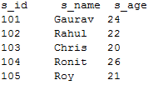
Output

Slide 222
JPA ORDER BY Clause
The ORDER BY clause is used to sort the data and arrange them either in ascending or descending order. The CriteriaQuery interface provides orderBy() method to define the type of ordering.
ORDER BY Example
Here, we will perform several ORDER BY operations on student table. Let us assume the table contains the following records: -

Slide 223
StudentEntity.java
Create an entity class. Here, we created StudentEntity.java under com.javatpoint.jpa package. This class contains three attributes s_id, s_name, s_age with all the required annotations.
package com.javatpoint.jpa;
import javax.persistence.*;
@Entity
@Table(name="student")
public class StudentEntity {
@Id
private int s_id;
private String s_name;
private int s_age;
public StudentEntity(int s_id, String s_name, int s_age) {
super();
this.s_id = s_id;
this.s_name = s_name;
this.s_age = s_age;
}
public StudentEntity() {
super();
}
public int getS_id() {
return s_id;
}
public void setS_id(int s_id) {
this.s_id = s_id;
}
public String getS_name() {
return s_name;
}
public void setS_name(String s_name) {
this.s_name = s_name;
}
public int getS_age() {
return s_age;
}
public void setS_age(int s_age) {
this.s_age = s_age;
}
}

Slide 224
Persistence.xml
Now, map the entity class and other databases confiuguration in Persistence.xml file.
<persistence>
<persistence-unit name="Student_details">
<class>com.javatpoint.jpa.StudentEntity</class>
<properties>
<property name="javax.persistence.jdbc.driver" value="com.mysql.jdbc.Driver"/>
<property name="javax.persistence.jdbc.url" value="jdbc:mysql://localhost:3306/studentdata"/>
<property name="javax.persistence.jdbc.user" value="root"/>
<property name="javax.persistence.jdbc.password" value=""/>
<property name="eclipselink.logging.level" value="SEVERE"/>
<property name="eclipselink.ddl-generation" value="create-or-extend-tables"/>
</properties>
</persistence-unit>
</persistence>

Slide 225
Sorting in ascending order
Asc.java
package com.javatpoint.jpa.jpql;
import com.javatpoint.jpa.StudentEntity;
import javax.persistence.*;
import javax.persistence.criteria.*;
import java.util.*;
public class Asc {
public static void main( String args[]) {
EntityManagerFactory emf = Persistence.createEntityManagerFactory( "Student_details" );
EntityManager em = emf.createEntityManager();
em.getTransaction().begin( );
CriteriaBuilder cb=em.getCriteriaBuilder();
CriteriaQuery<StudentEntity> cq=cb.createQuery(StudentEntity.class);
Root<StudentEntity> stud=cq.from(StudentEntity.class);
cq.orderBy(cb.asc(stud.get("s_age")));
CriteriaQuery<StudentEntity> select = cq.select(stud);
TypedQuery<StudentEntity> q = em.createQuery(select);
List<StudentEntity> list = q.getResultList();
System.out.print("s_id");
System.out.print("\t s_name");
System.out.println("\t s_age");
for(StudentEntity s:list)
{
System.out.print(s.getS_id());
System.out.print("\t"+s.getS_name());
System.out.println("\t"+s.getS_age());
}
em.getTransaction().commit();
em.close();
emf.close();
}

Slide 226
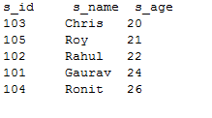
output:

Slide 227
Sorting in descending order
Desc.java
package com.javatpoint.jpa.jpql;
import com.javatpoint.jpa.StudentEntity;
import javax.persistence.*;
import javax.persistence.criteria.*;
import java.util.*;
public class Desc {
public static void main( String args[]) {
EntityManagerFactory emf = Persistence.createEntityManagerFactory( "Student_details" );
EntityManager em = emf.createEntityManager();
em.getTransaction().begin( );
CriteriaBuilder cb=em.getCriteriaBuilder();
CriteriaQuery<StudentEntity> cq=cb.createQuery(StudentEntity.class);
Root<StudentEntity> stud=cq.from(StudentEntity.class);
cq.orderBy(cb.desc(stud.get("s_age")));
CriteriaQuery<StudentEntity> select = cq.select(stud);
TypedQuery<StudentEntity> q = em.createQuery(select);
List<StudentEntity> list = q.getResultList();
System.out.print("s_id");
System.out.print("\t s_name");
System.out.println("\t s_age");
for(StudentEntity s:list)
{
System.out.print(s.getS_id());
System.out.print("\t"+s.getS_name());
System.out.println("\t"+s.getS_age());
}
em.getTransaction().commit();
em.close();
emf.close();
}
}

Slide 228
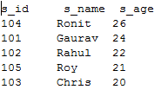
output:

Slide 229
JPA Criteria WHERE Clause
https://www.javatpoint.com/jpa-criteria-where-clause

Slide 230
JPA Criteria GROUP BY Clause
https://www.javatpoint.com/jpa-criteria-group-by-clause

Slide 231
JPA Criteria Having clause
https://www.javatpoint.com/jpa-criteria-having-clause

